Slide 1
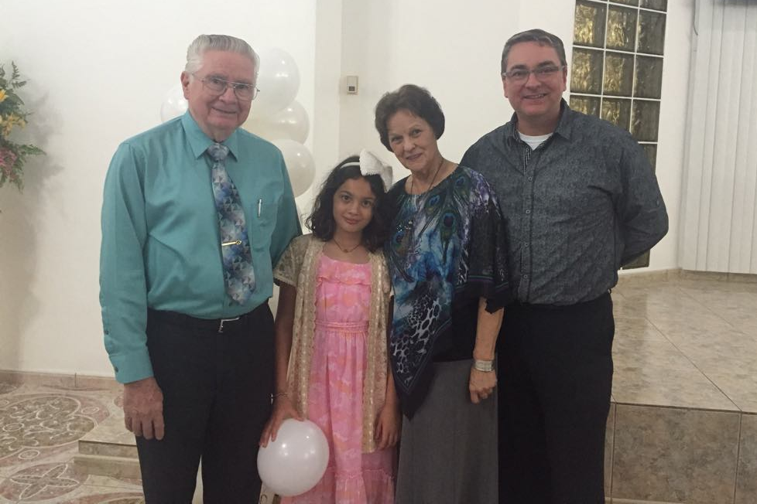
“Farewell” Event held by Puerto Rico Christians for the Shappley’s
April 30, 2016
Two days before their completion of fifty years of work in God’s Kingdom there.
Five days before their definitive departure for their new home in Tamarac, Florida.

Slide 2
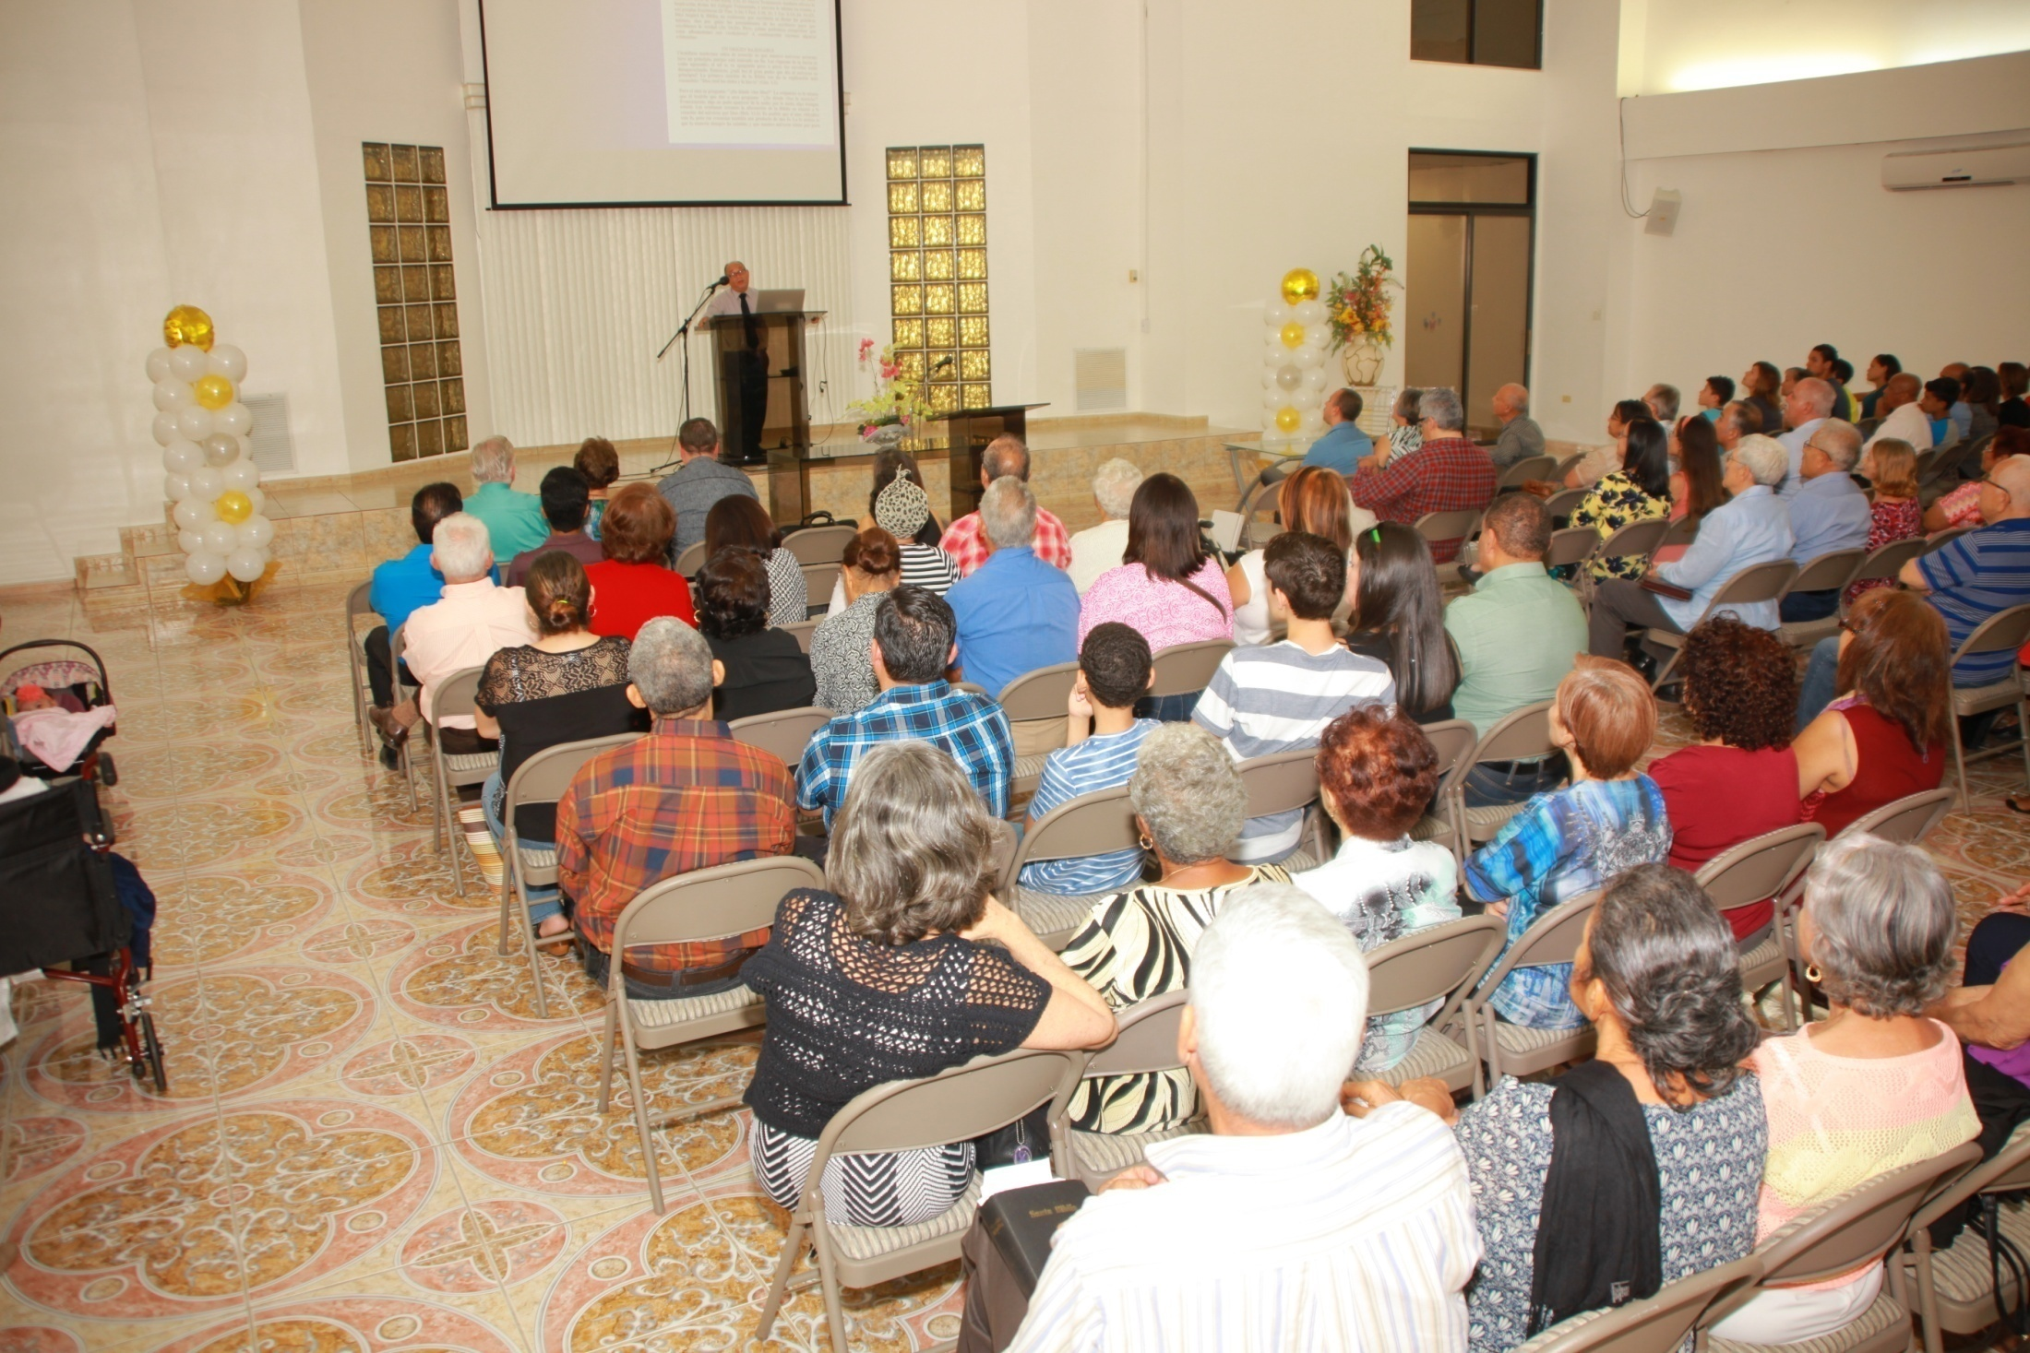
The event was conducted Saturday, April 30, 2016, beginning at 4 pm, in the meeting place of the Bayamon, Puerto Rico church of Christ. It was organized by brethren in Bayamon, with the cooperation of the Gurabo and Cubuy churches.

Slide 3
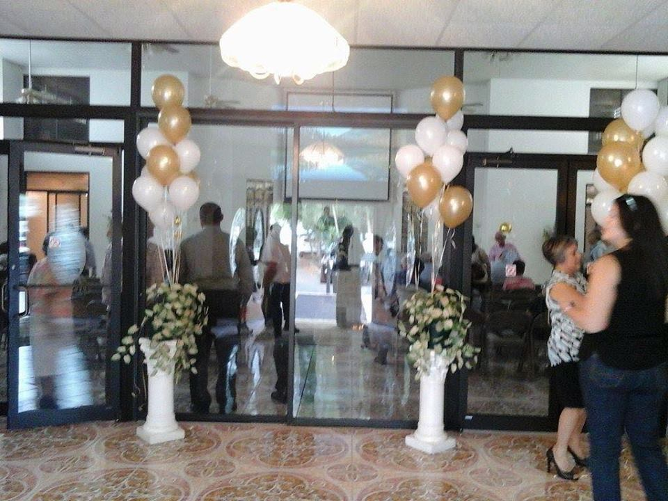
In the Bayamon church building, looking from the vestibule through the tinted glass doors and partitions, into the auditorium. Pleasing decorations all around!

Slide 4
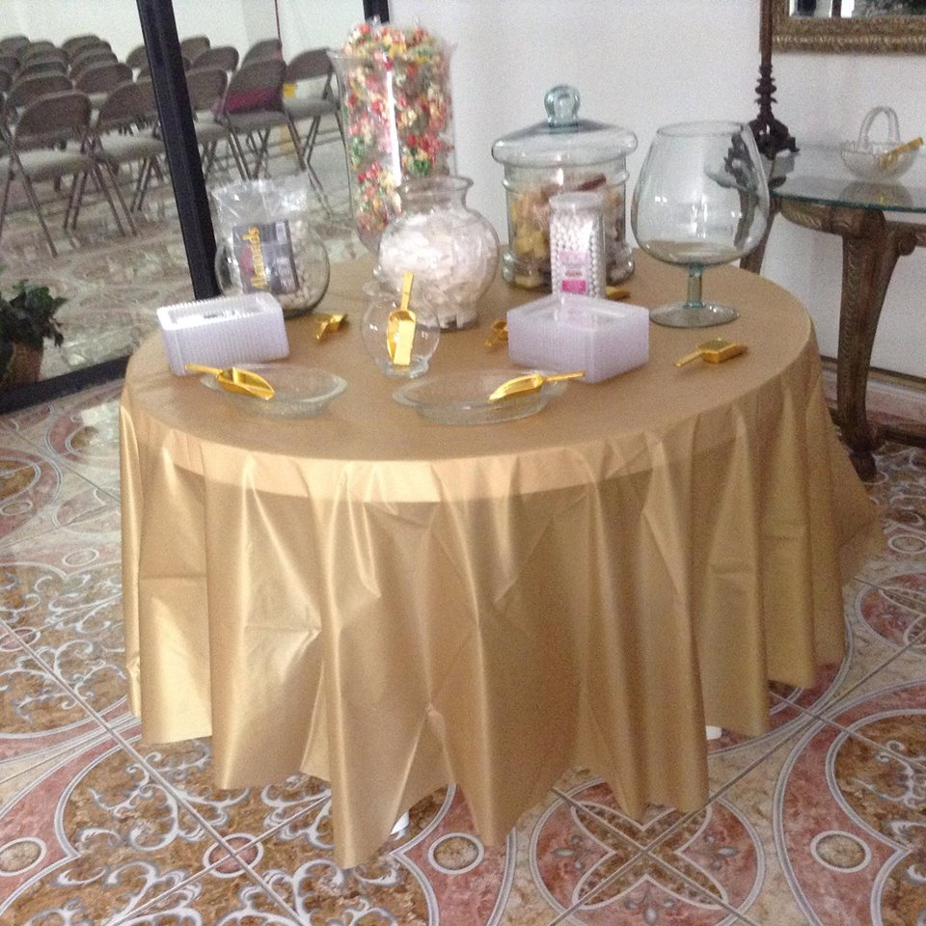
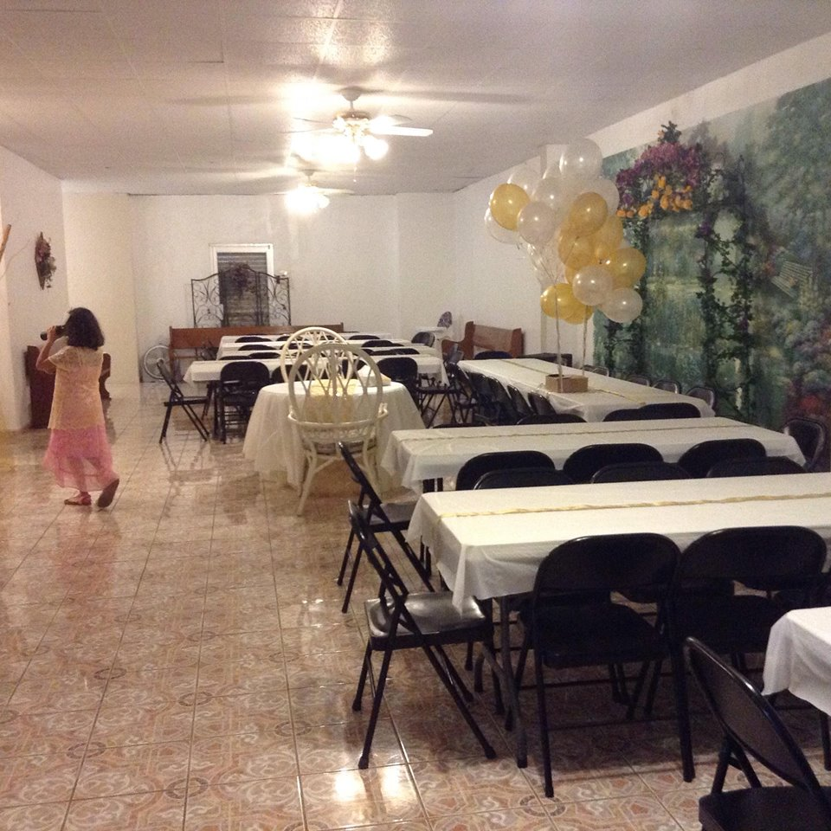
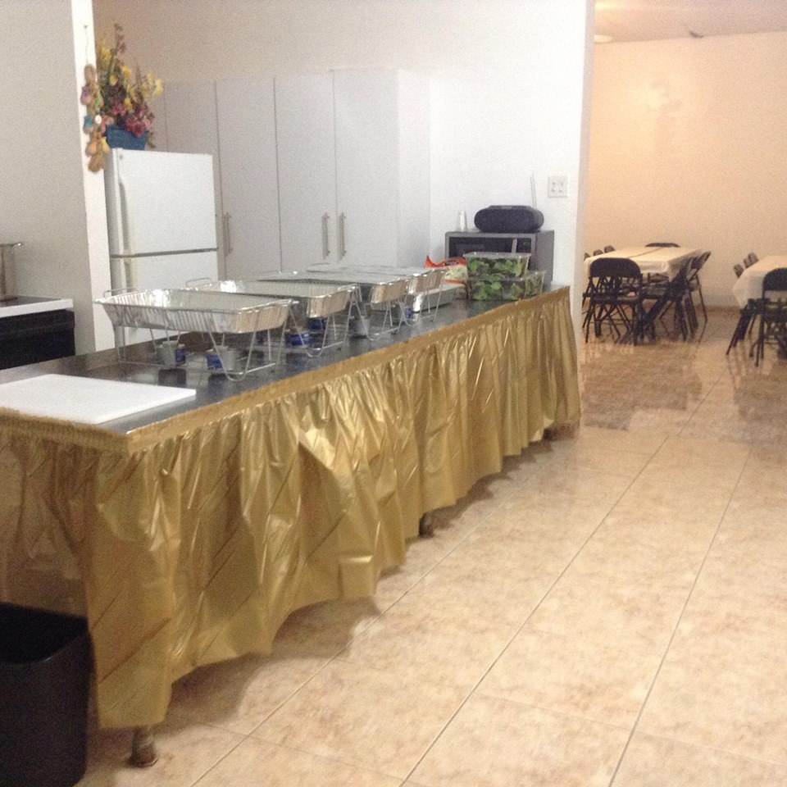
A table, with treats, in the vestibule.
Serving trays in the kitchen.
Tables for the dinner to be served.

Slide 5
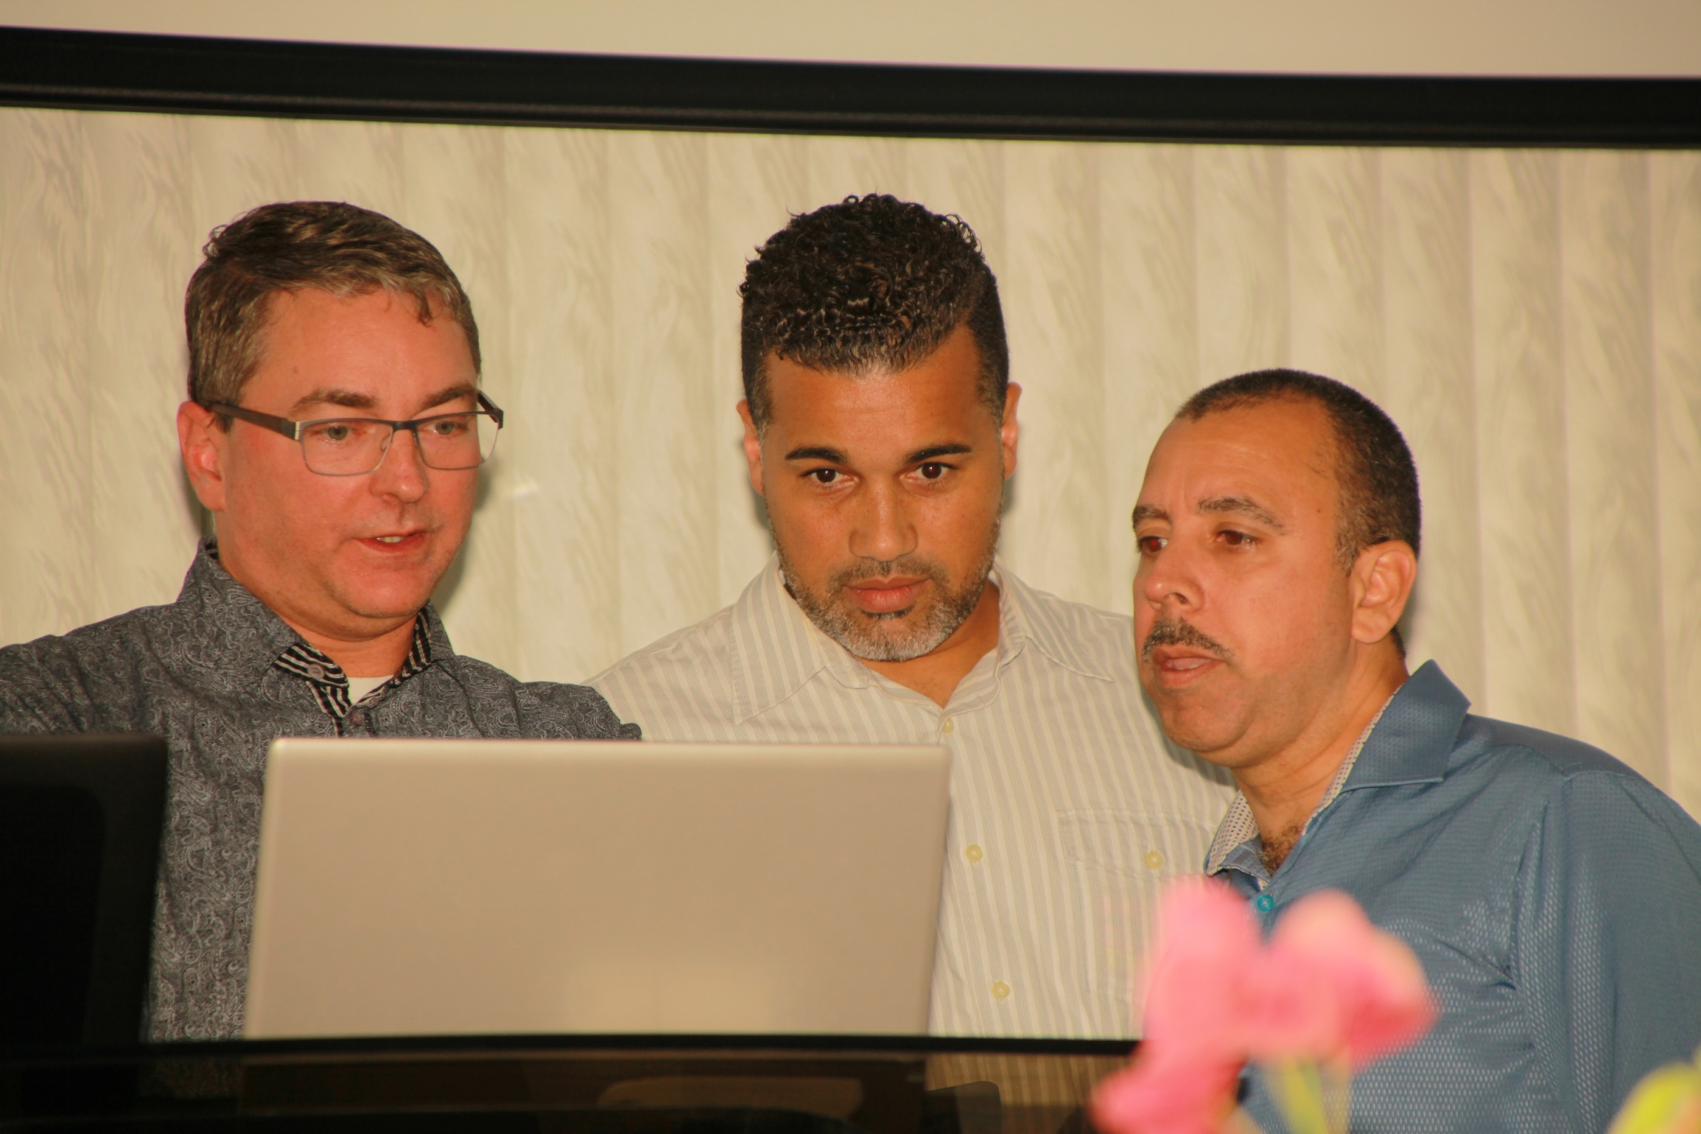
Preliminary coordination for the program by Antonio Shappley, song leader for the event, José Juan Álamo and Jorge Ginés, deacons of the Bayamon church.

Slide 6
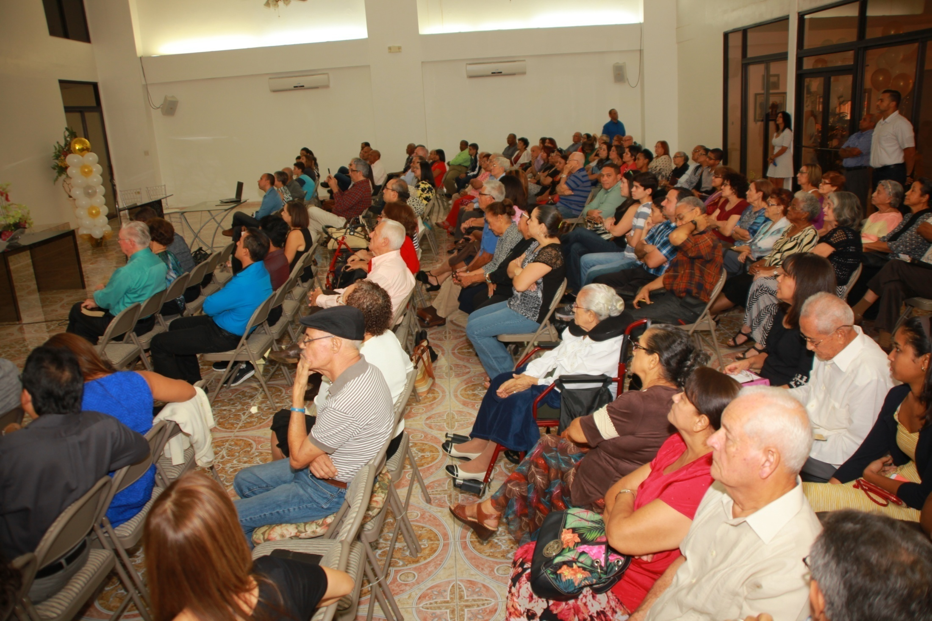
One hundred sixty, from nine different congregations, attended. Advanced years and/or sickness kept a number from attending. Fifty years in a place and work are a “lifetime,” as Puerto Ricans are accustomed to say.

Slide 7
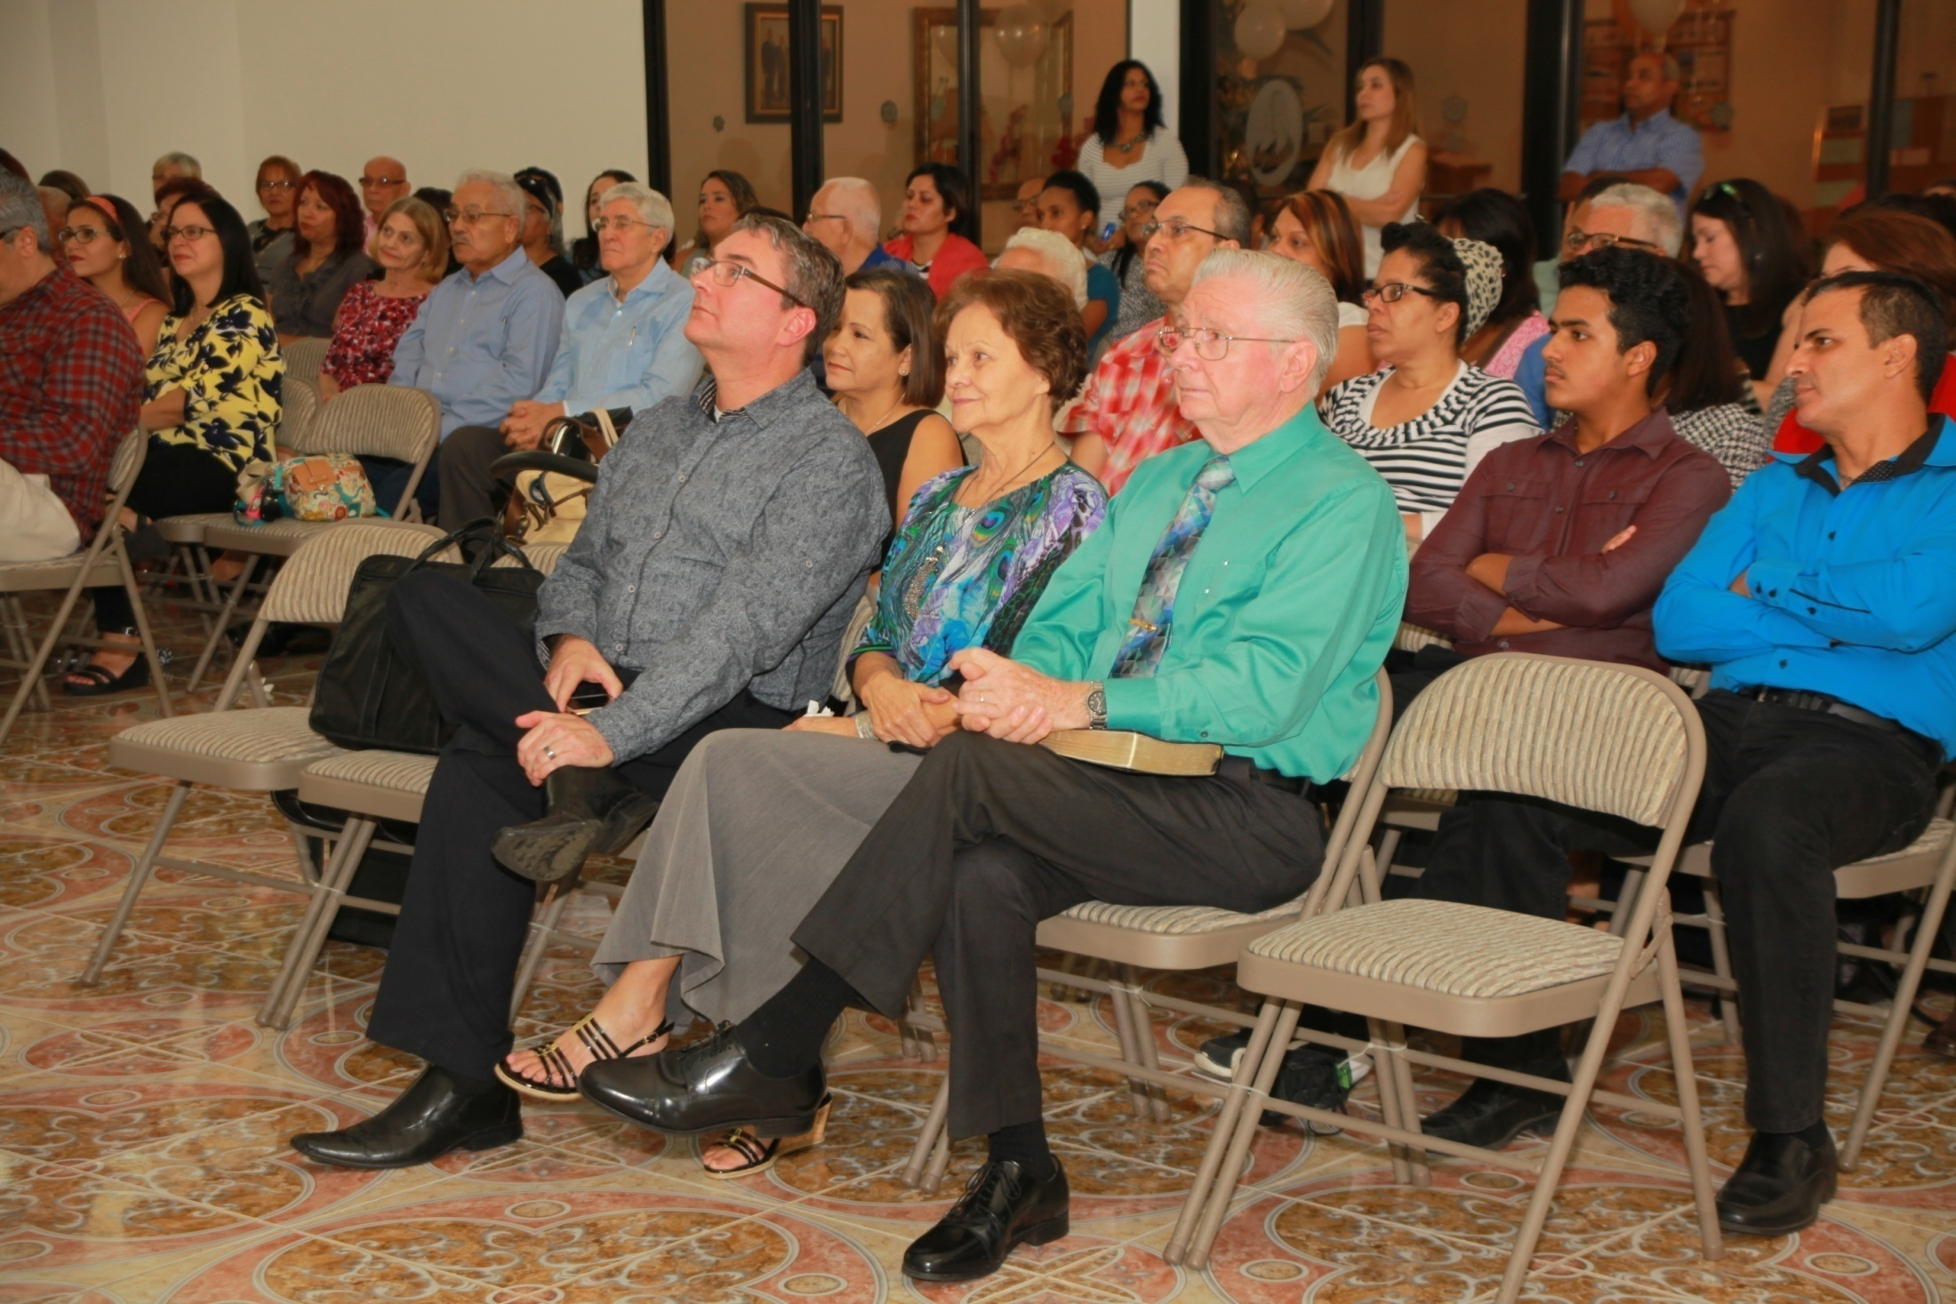
Dewayne, Rita and Antonio Shappley occupy front row seats during the introduction by Alfonso Estrella, one of three elders of the Bayamon church.

Slide 8
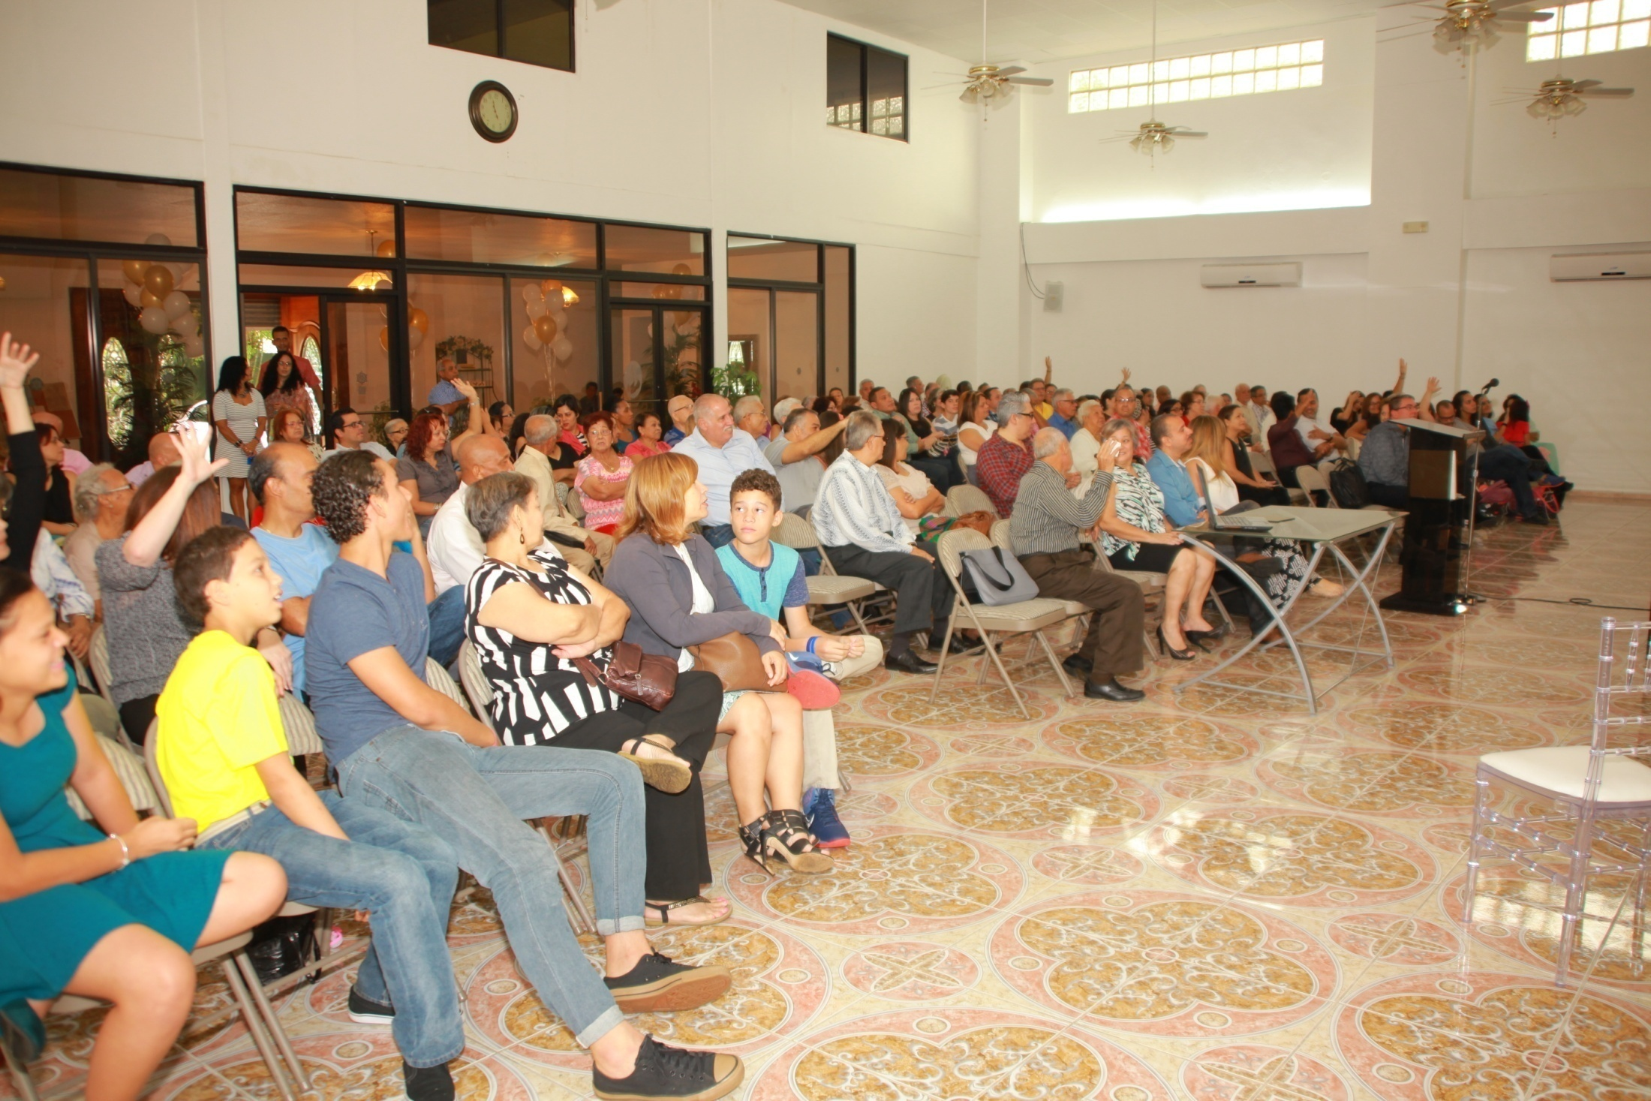
Another view of those present for the event. Entrance to this auditorium is through the spacious lobby behind the tinted glass partition and doors.

Slide 9
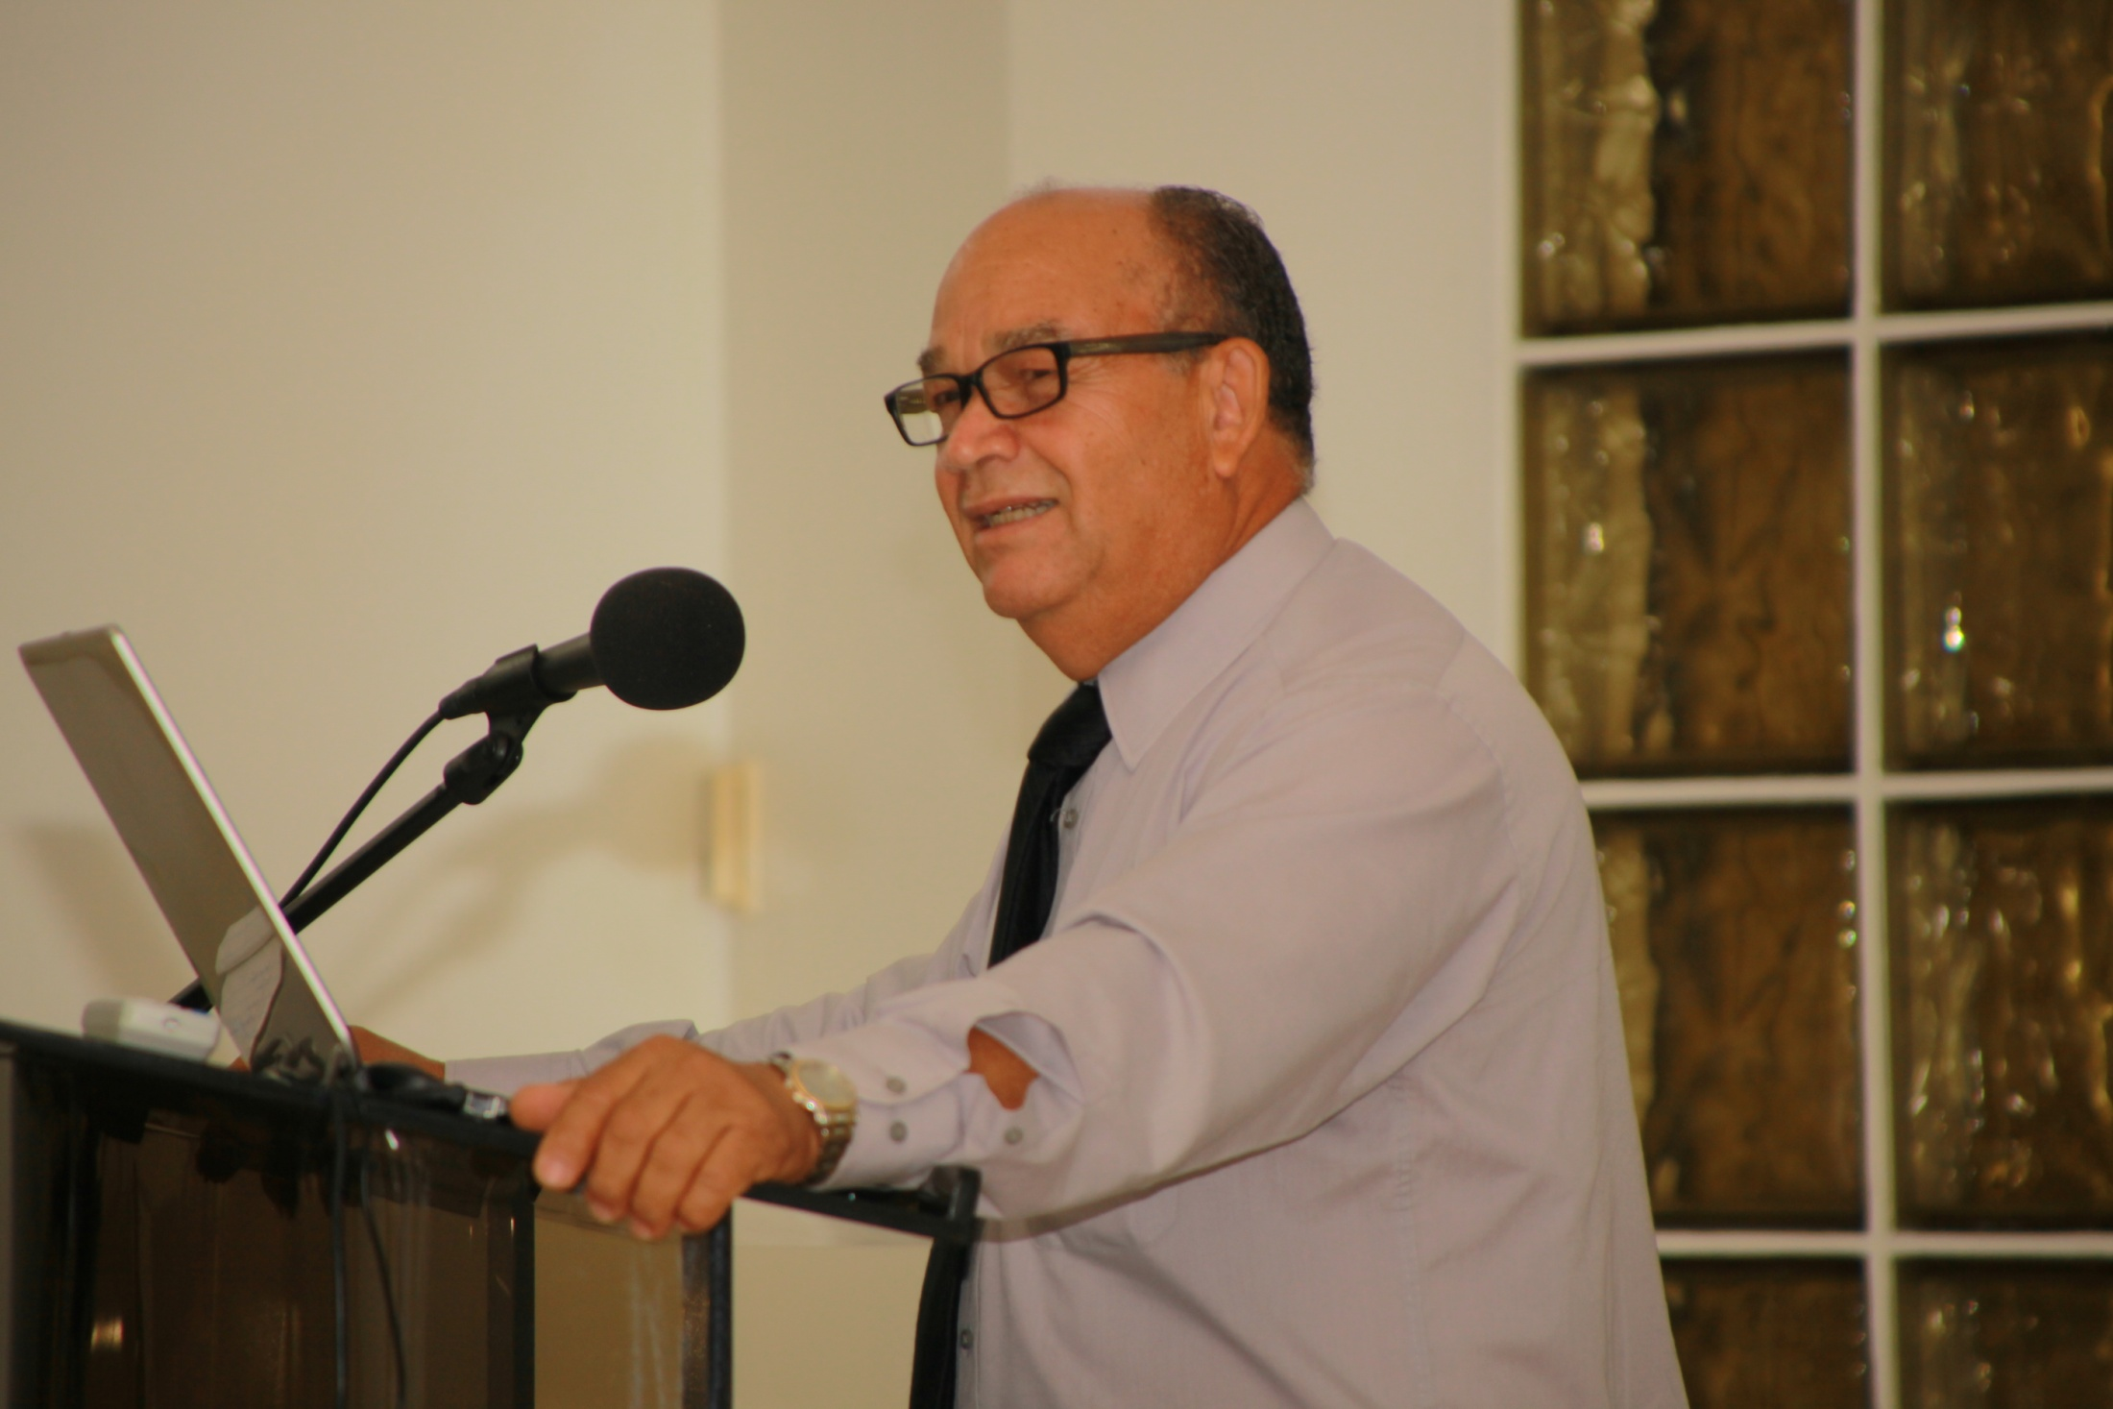
Bro. Alfonso Estrella, elder, very capable preacher, teacher and song leader, opens the event. He uses the next eleven slides to present a Brief Review of the Shappley’s work.

Slide 10
A Brief Review of Works Carried Out by the Shappley’s in Puerto Rico
1966 -2016
Principal places where the Shappley’s have worked are indicated by the orange circles.

Slide 11
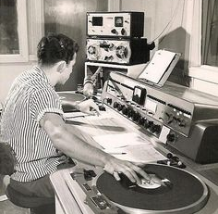
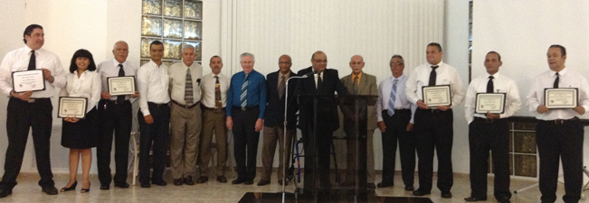
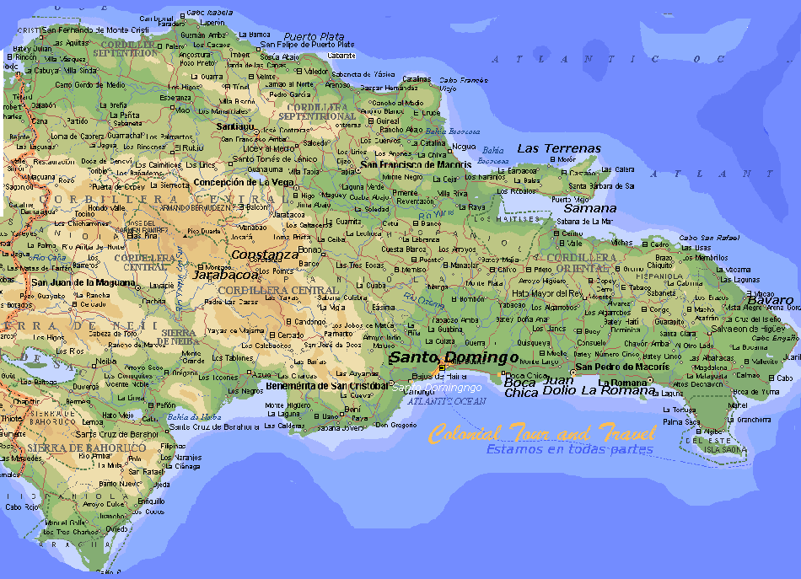
A few months after their arrival in 1966, Bro. Shappley was asked to take charge of a radio program. He continued to have weekly programs for over 30 years on stations KVM, then Sal-Soul and, later, WIAC.
A lot of time on the highways: evangelism in homes throughout the island and gospel meetings.
Numerous trips to the Dominican Republic for evangelism.
25 consecutive years as teacher in the School of Advanced Bible Studies for churches of Christ in Puerto Rico.

Slide 12
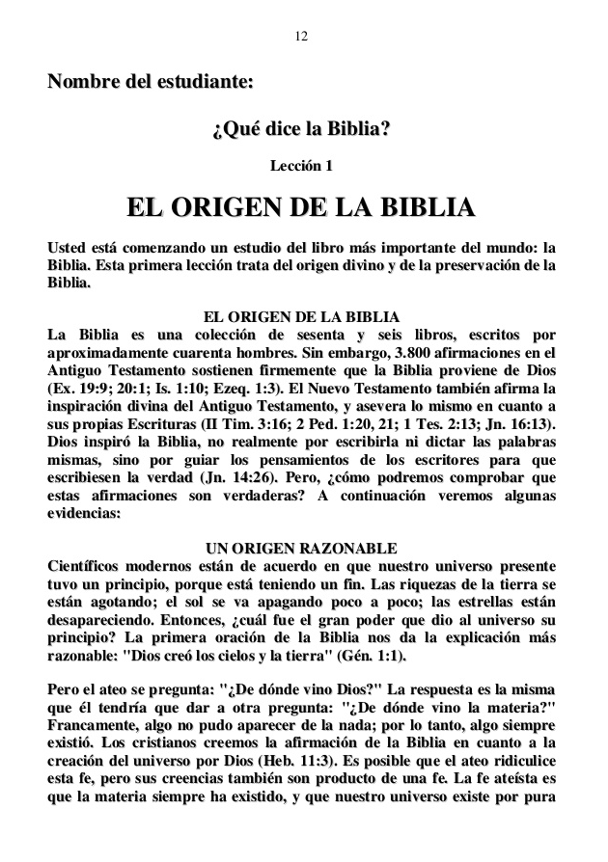
The 11 lesson Bible course “What Does the Bible Say?” was offered in newspapers.
Soon, the number of students reached 3,000.
Very large numbers of lessons were needed!
This circunstance lead to the decision to buy a small printing press, which was installed in the bedroom of the Shappley house in Sierra Bayamón… and Sword of the Spirit Press was born, later named Editorial La Paz.

Slide 13
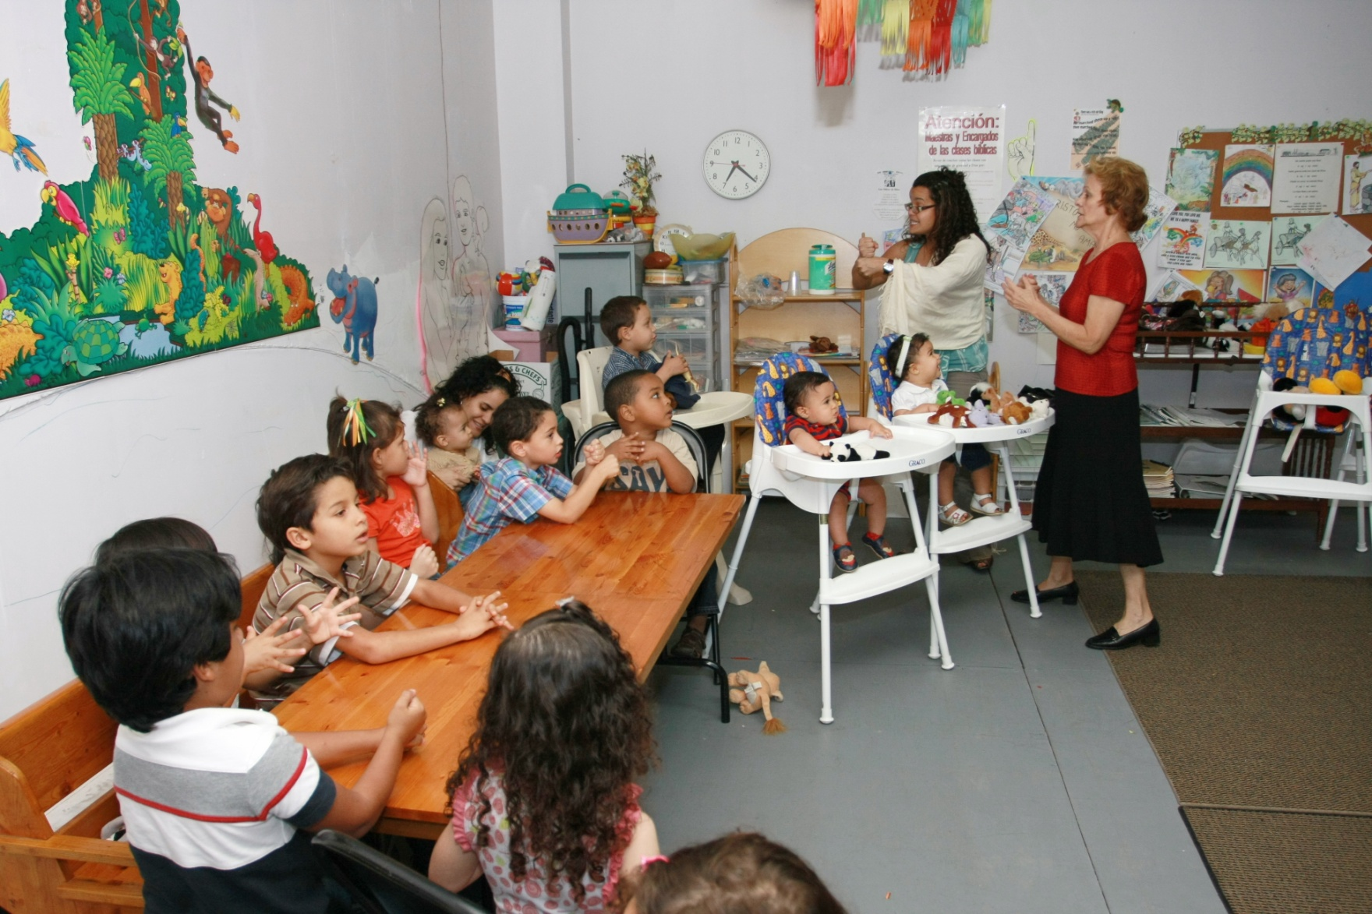
Year after year, Rita Shappley teaches classes for children, young people, girls only and women, motivating and training other ladies for these ministries. She organizes and carries out a great number of activities for youth. She prepares a very large quantity of materials for Bible classes. And works for a number of years in the printing facility, designing publication covers, cassette and CD labels, making hundreds of thousands of copies of cassettes, CD’s, manuals and books.

Slide 14
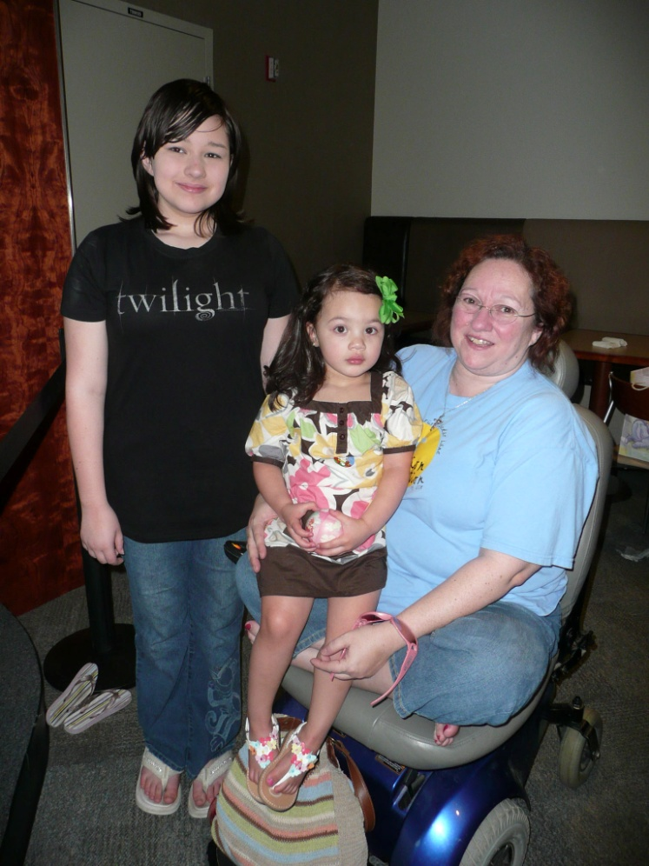
Sharon Laretta Shappley, with her daughter Michaela and neice Kiara Karina, a few years ago.
Raised in Puerto Rico from the time she was 6, Lala, as she is affectionately known there, also teaches a great number of classes for children, actively participating in all kinds of activities, especially in the Bayamon congregation.

Slide 15
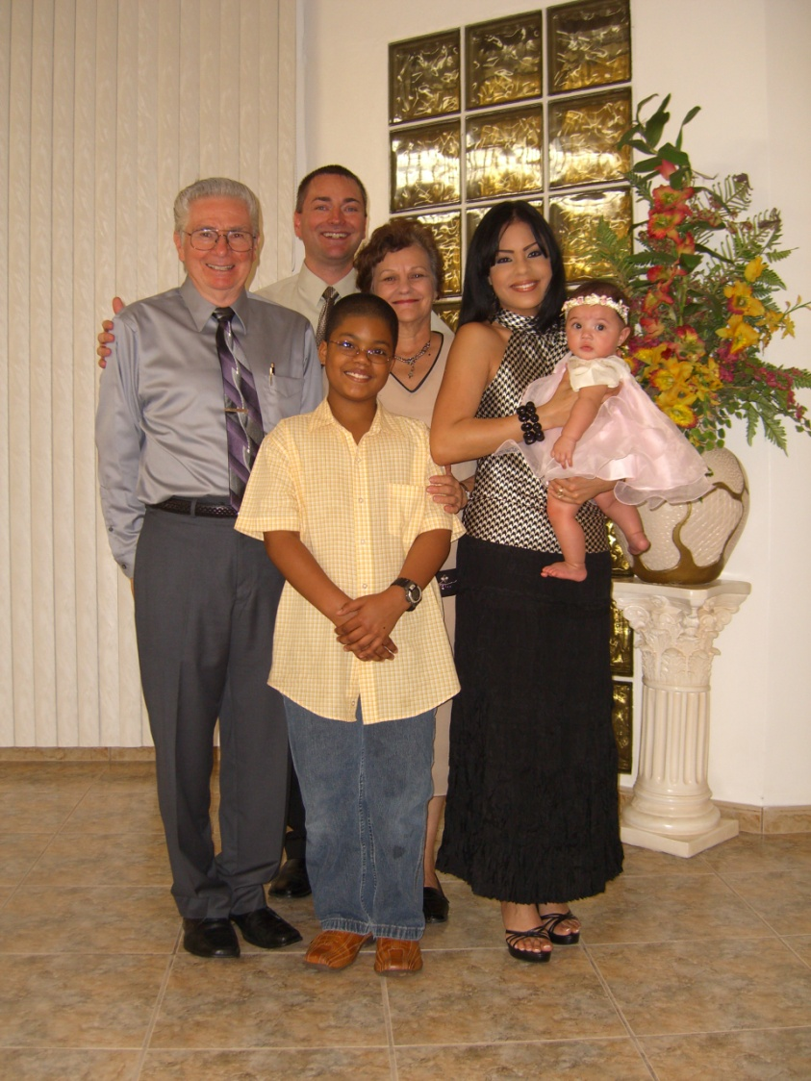
Antonio Shappley was born in Puerto Rico, in 1969.
He learned to operate the printing machinery and worked for 3 years in the plant.
When 13 years old, he sang in the chorus of 18 Christians who recorded the LP “Jesucristo te convida.”
Using his special gift for singing multiple voices, he has recorded 172 hymns in Spanish.
His wife is Irelis Caride Flores, of Guaynabo, Puerto Rico.
www.alabanzas.info

Slide 16
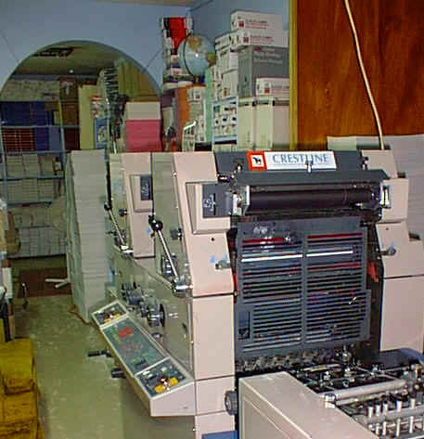
Throughout Latin America, materials prepared in the printing plant came to be in high demand.
28,300,665 tracts, booklets, books, cassettes and CD’s were produced.

Slide 17
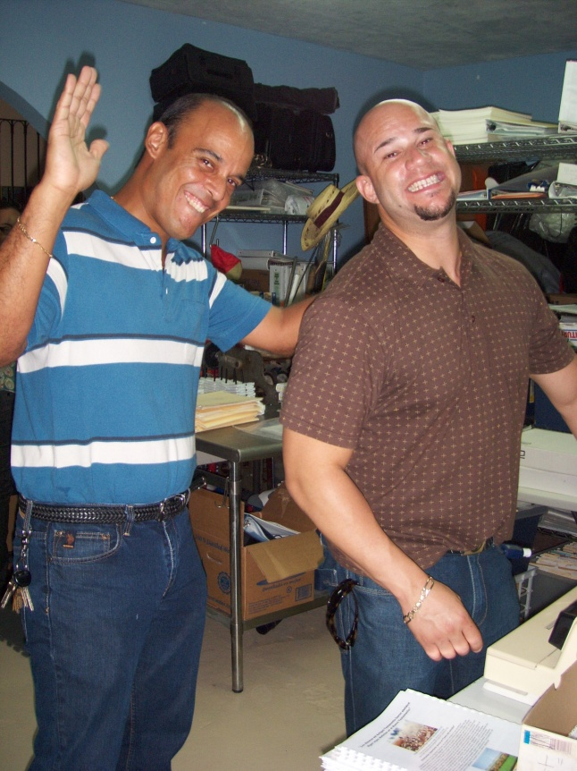
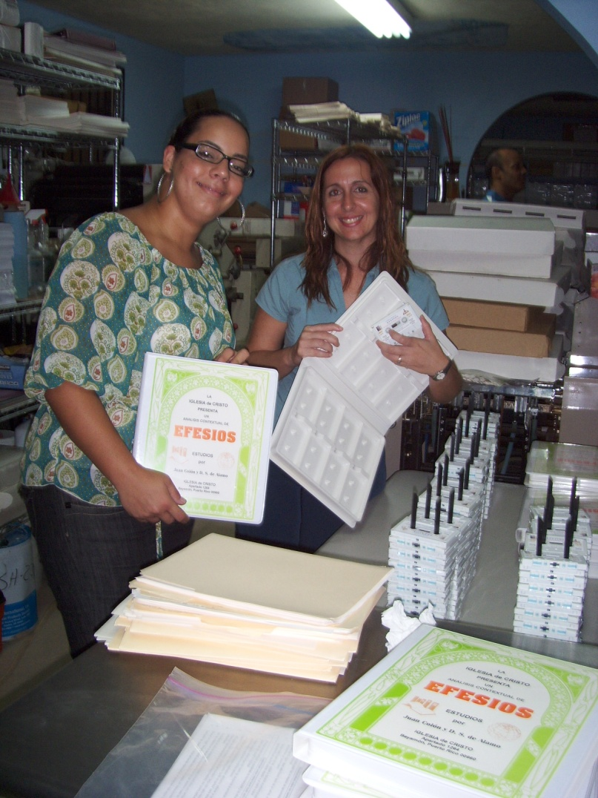
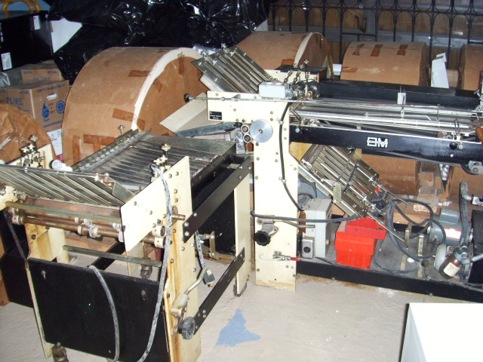
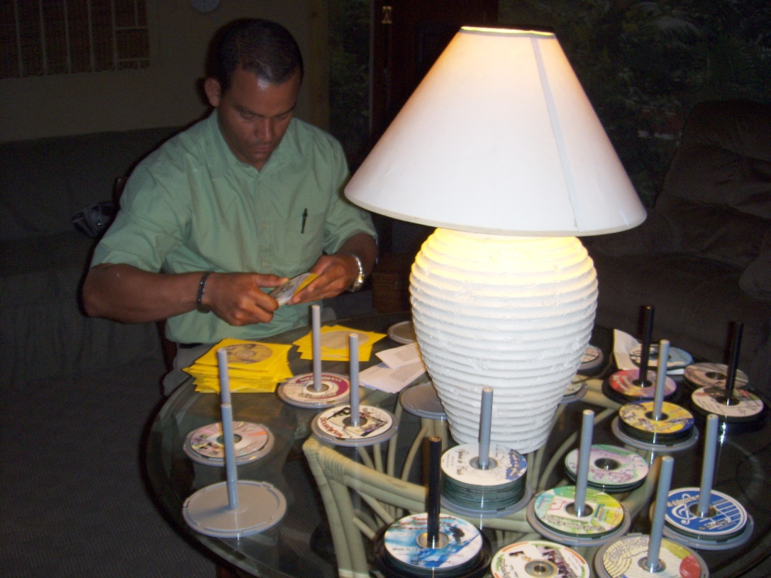
Many donated time and energy to different tasks in the printing plant.

Slide 18
With God’s blessings, the printing and audio projects produced, abundant fruits.
But, in 2007, a sudden 300% increase in the cost of shipping made continuation of the project increasingly difficult, resulting in its termination in 2010.
Beginning in 2003, Editorial La Paz had established its presence on the Internet, and continues to the present day.
The Home Page of www.editoriallapaz.org

Slide 19
Sites on the Internet Designed and Developed by Dewayne and Antonio Shappley
www.editoriallapaz.org www.iglesia-de-cristo.com www.apocalipsis.co
DATA from January, 2003 through March 31, 2016.
14,533,127 visits 28,284,411 documents opened
In addition, an average of 15,000 visits per month are registered to www.alabanzas.info, with 172 hymns available.
The Grand Total of digital documents, printed materials and audio: 56,584,076.
Fruits registered:
Approximately 14,425 conversions
246 congregations begun in different countries.

Slide 20
And the work continues…
During the later part of 2015, a version of www.editoriallapaz.org for intelligent phones is introduced. The audience on the Internet grows even more, reaching a daily average of 5,210 for March, 2016.
We ask your prayers on behalf of the continuation of these effective works of evangelism and edification.

Slide 21
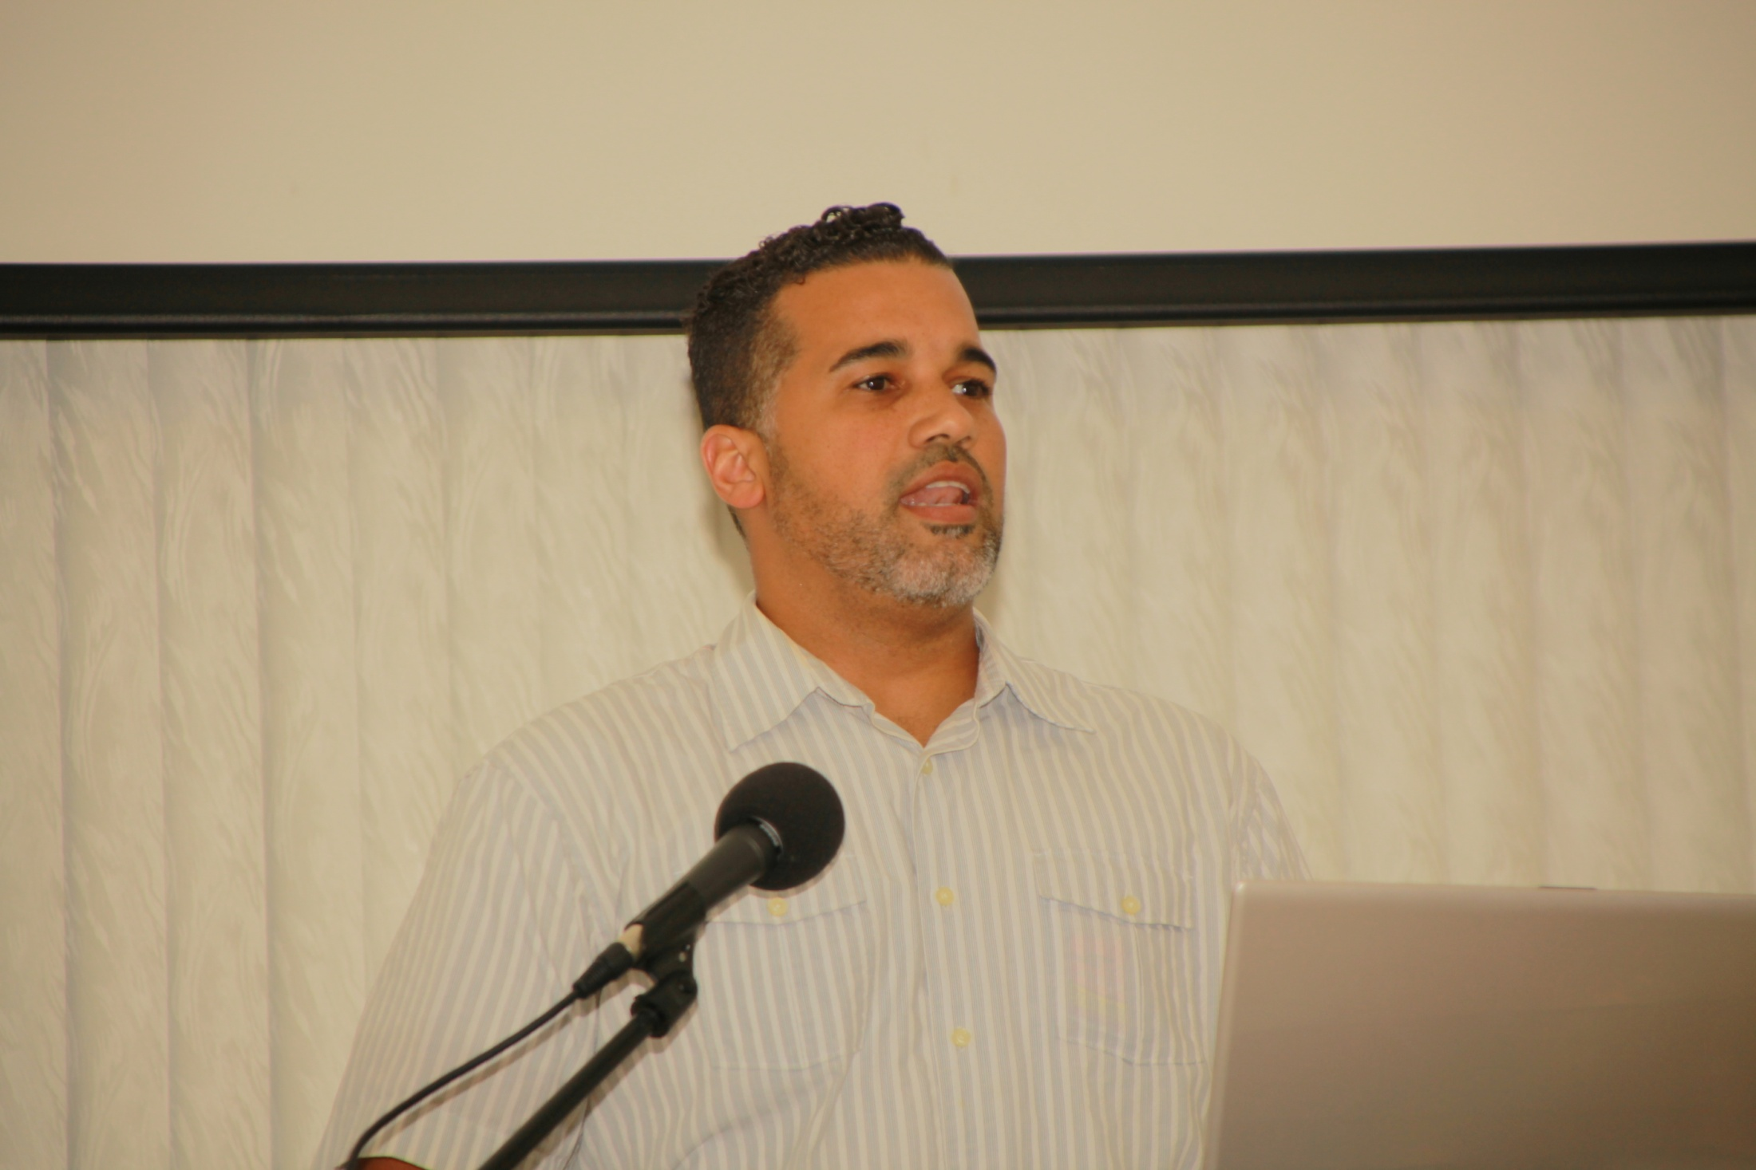
After Bro. Estrellas’ introduction and Brief Report, Bro. José Juan Álamo, deacon, preacher, teacher and song leader in Bayamon, took over as Master of Ceremonies.

Slide 22
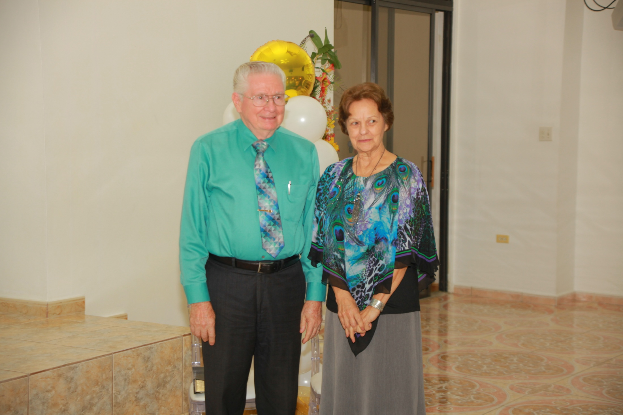
Dewayne and Rita were asked to come forward and take chairs in front of those present. (The Shappley’s have been married for 58 years.)

Slide 23
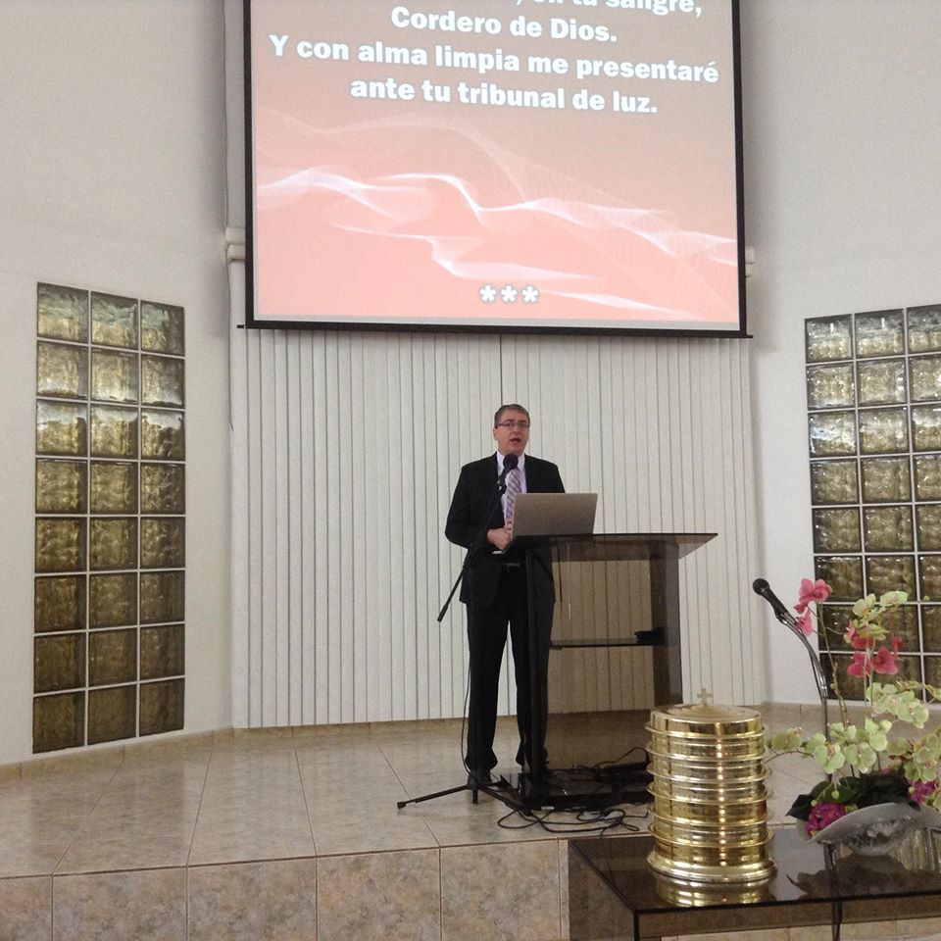
Antonio Shappley lead several songs during the event. He and his daughter Kiara Karina came from Coral Springs, Florida for four days in Puerto Rico. Suffering from Lyme Disease, Antonio’s wife, Irelis, was unable to make the trip.
Sharon Laretta Shappley, of Manchester, TN, could not attend due to various circumstances.

Slide 24
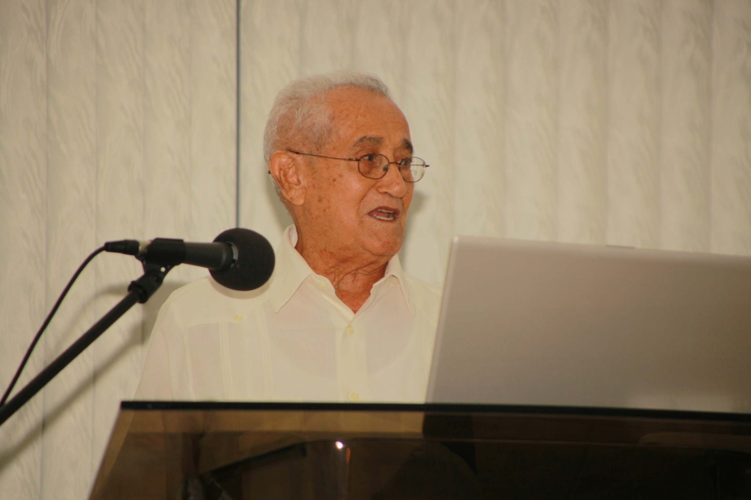
Bro. Alfredo Colón, 89 years of age, long-time member of the Ceiba congregation, was the first of several to relate works of the Shappley’s in their areas.

Slide 25
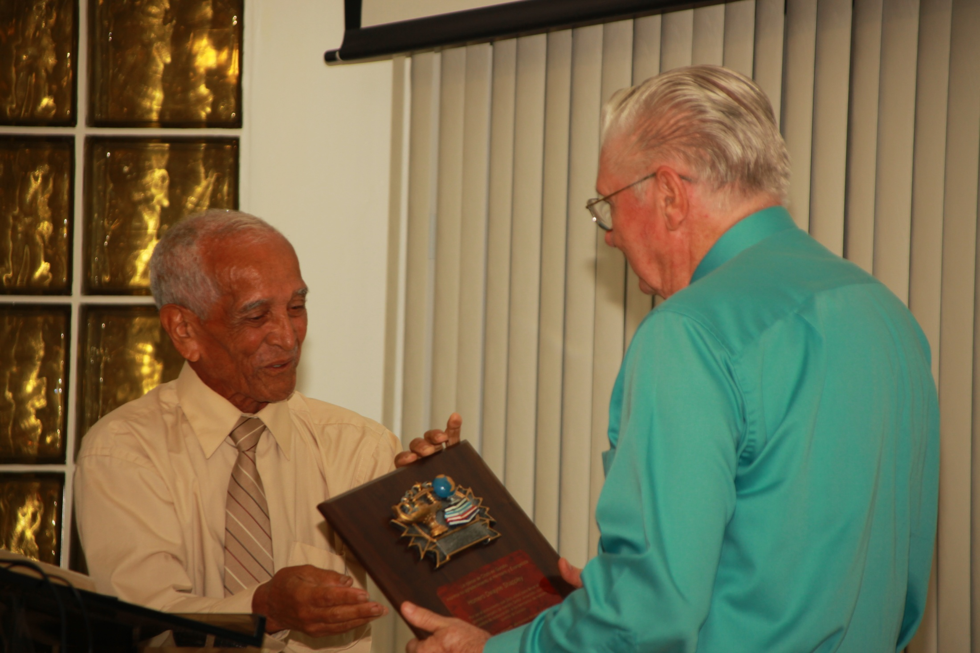
On behalf of the Gurabo congregation, Bro. Félix Roldán, elder, presented a plaque to the Shappley’s. The church there was established as the result of a radio program and scores of studies with mostly religious leaders of the community.

Slide 26
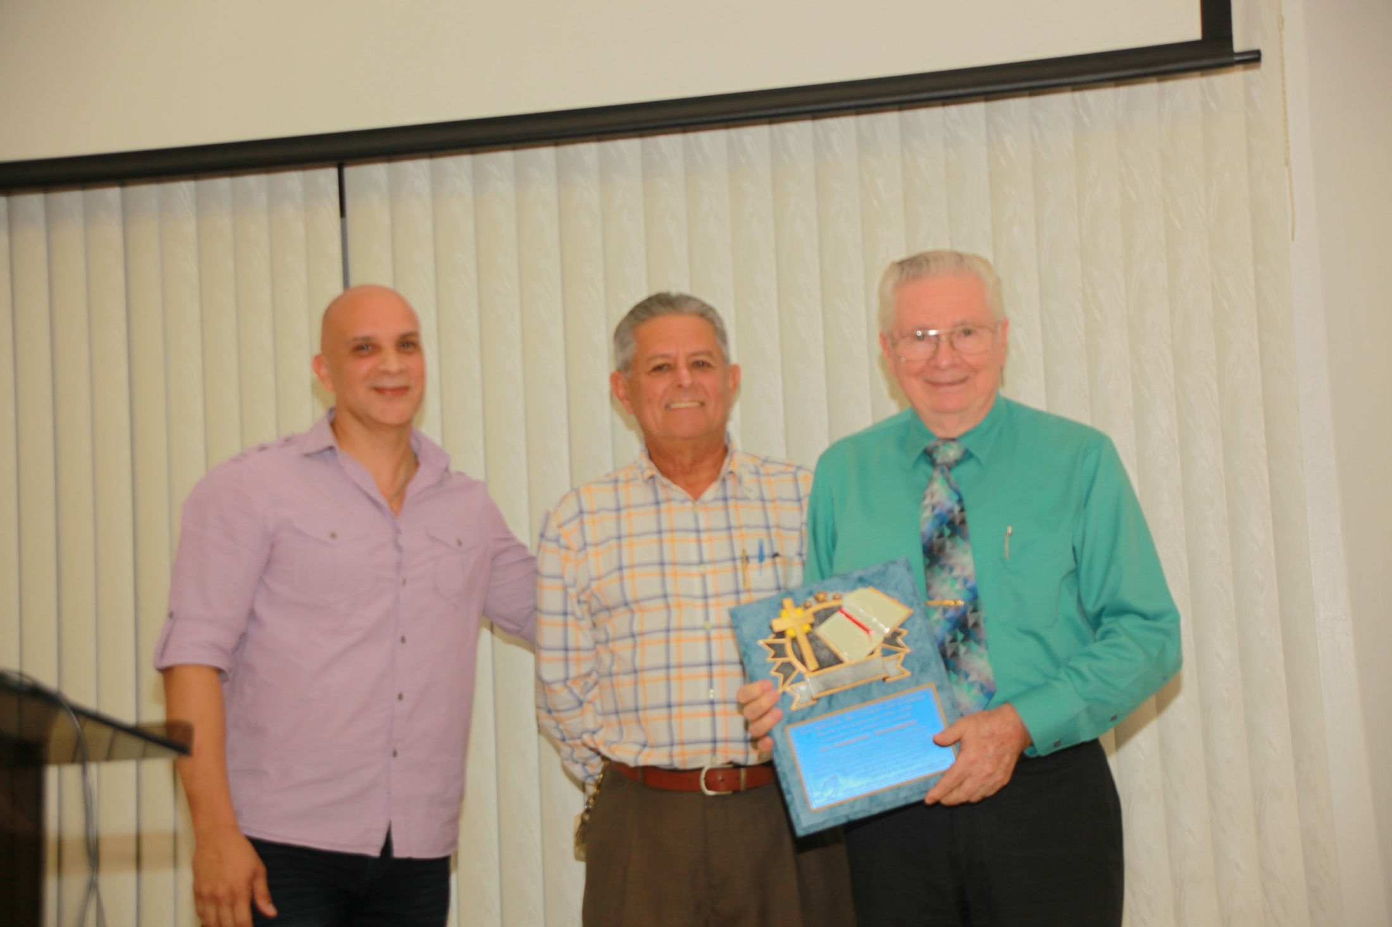
Johnny Camilo and José Rodríguez, leaders of the Barrio Cubuy congregation, present a beautiful plaque to the Shappley’s. The radio program, preaching in the Canóvanas town plaza and follow-up studies resulted in the formation of the Cubuy church.

Slide 27
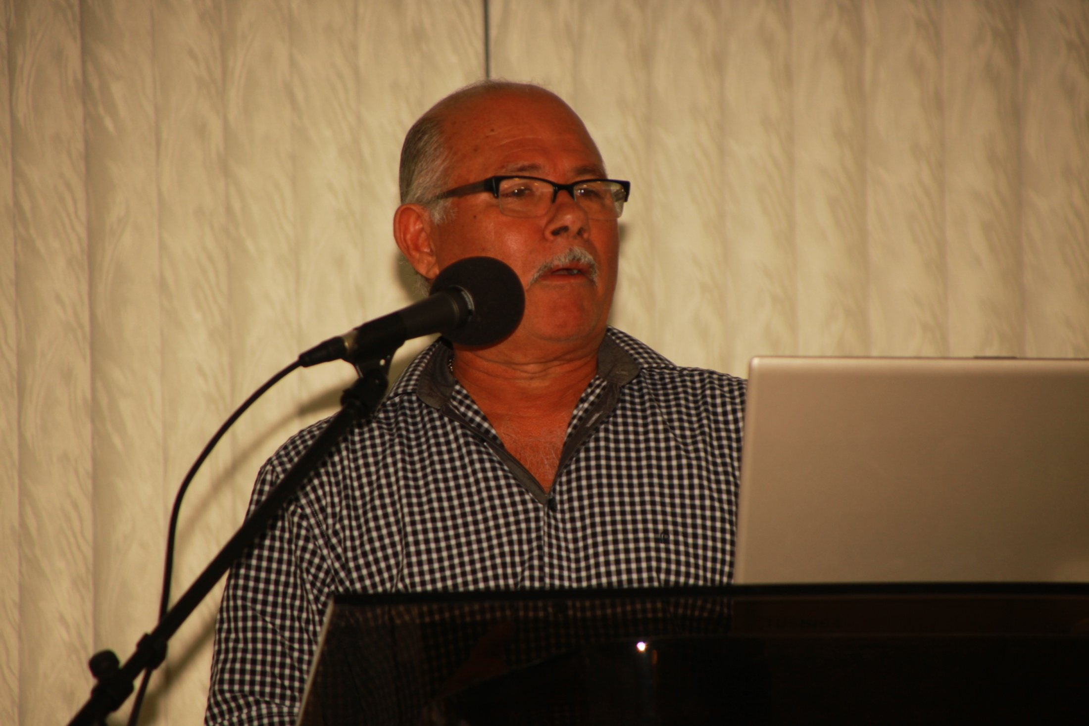
Chichín Rodríguez , of Barrio Cubuy, brother of José, took the microphone to tell how he had heard the same messages, but had moved, with his family, to Connecticut, without being baptized.
After a time in Connecticut, he and his wife became concerned about their spiritual welfare. Chichín said: “Let’s find a church like the one I heard about in Puerto Rico.” They did, an English-speaking one, and were baptized the next Sunday!
Chichín and his wife evangelized, in Spanish, members and friends of the family, works that resulted in the formation of a Spanish-speaking congregation in Farmington, Connecticut.

Slide 28
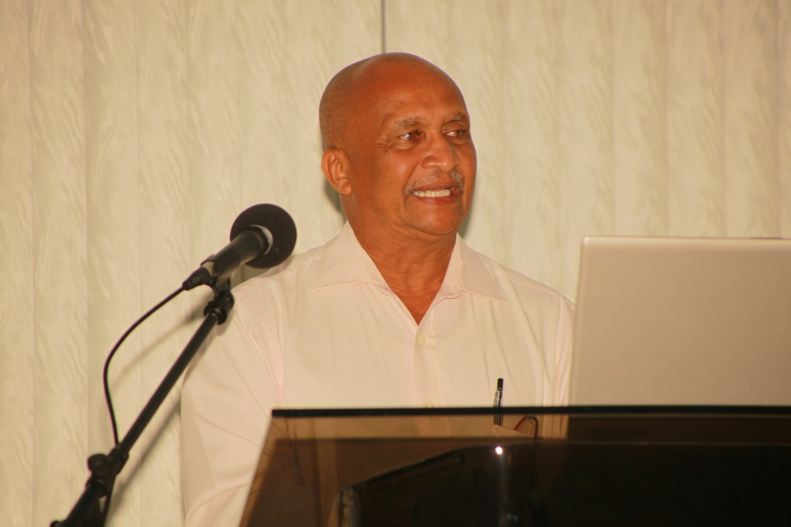
José Vizcarrondo of the Loiza congregation, tells how he was converted years after the establishment of the church in that Atlantic coastal town. The beginning of that church took place when five men were baptized one evening in the Atlantic ocean.
Of the five, Cicinio Quiñones had been a Pentecostal pastor. Later, Bibiano Salgado, another denominational leader, was converted, and these two men were pillars of the congregation before their passing away.
For years now, José Vizcarrondo has been taking the lead in Loiza. A very good preacher, he is also one of the directors and teachers of the School of Advanced Bible Studies. The self-supporting Loiza church has its own well appointed meeting place.

Slide 29
Efraín Reverón and Rafael Álamo, of the Park Gardens, Río Piedras congregation, recount their experiences with the Shappley’s. Efraín, 65, executive accountant of a business operating fast food chains, was a fifteen year old Christian when the Shappley’s arrived in Puerto Rico in 1966. He preaches some, as does Rafael.
Park Gardens is the first congregation the Shappley’s helped to begin in Puerto Rico. With an excellent property and building, this is where the School of Advanced Bible Studies has operated for 25 consecutive years.

Slide 30
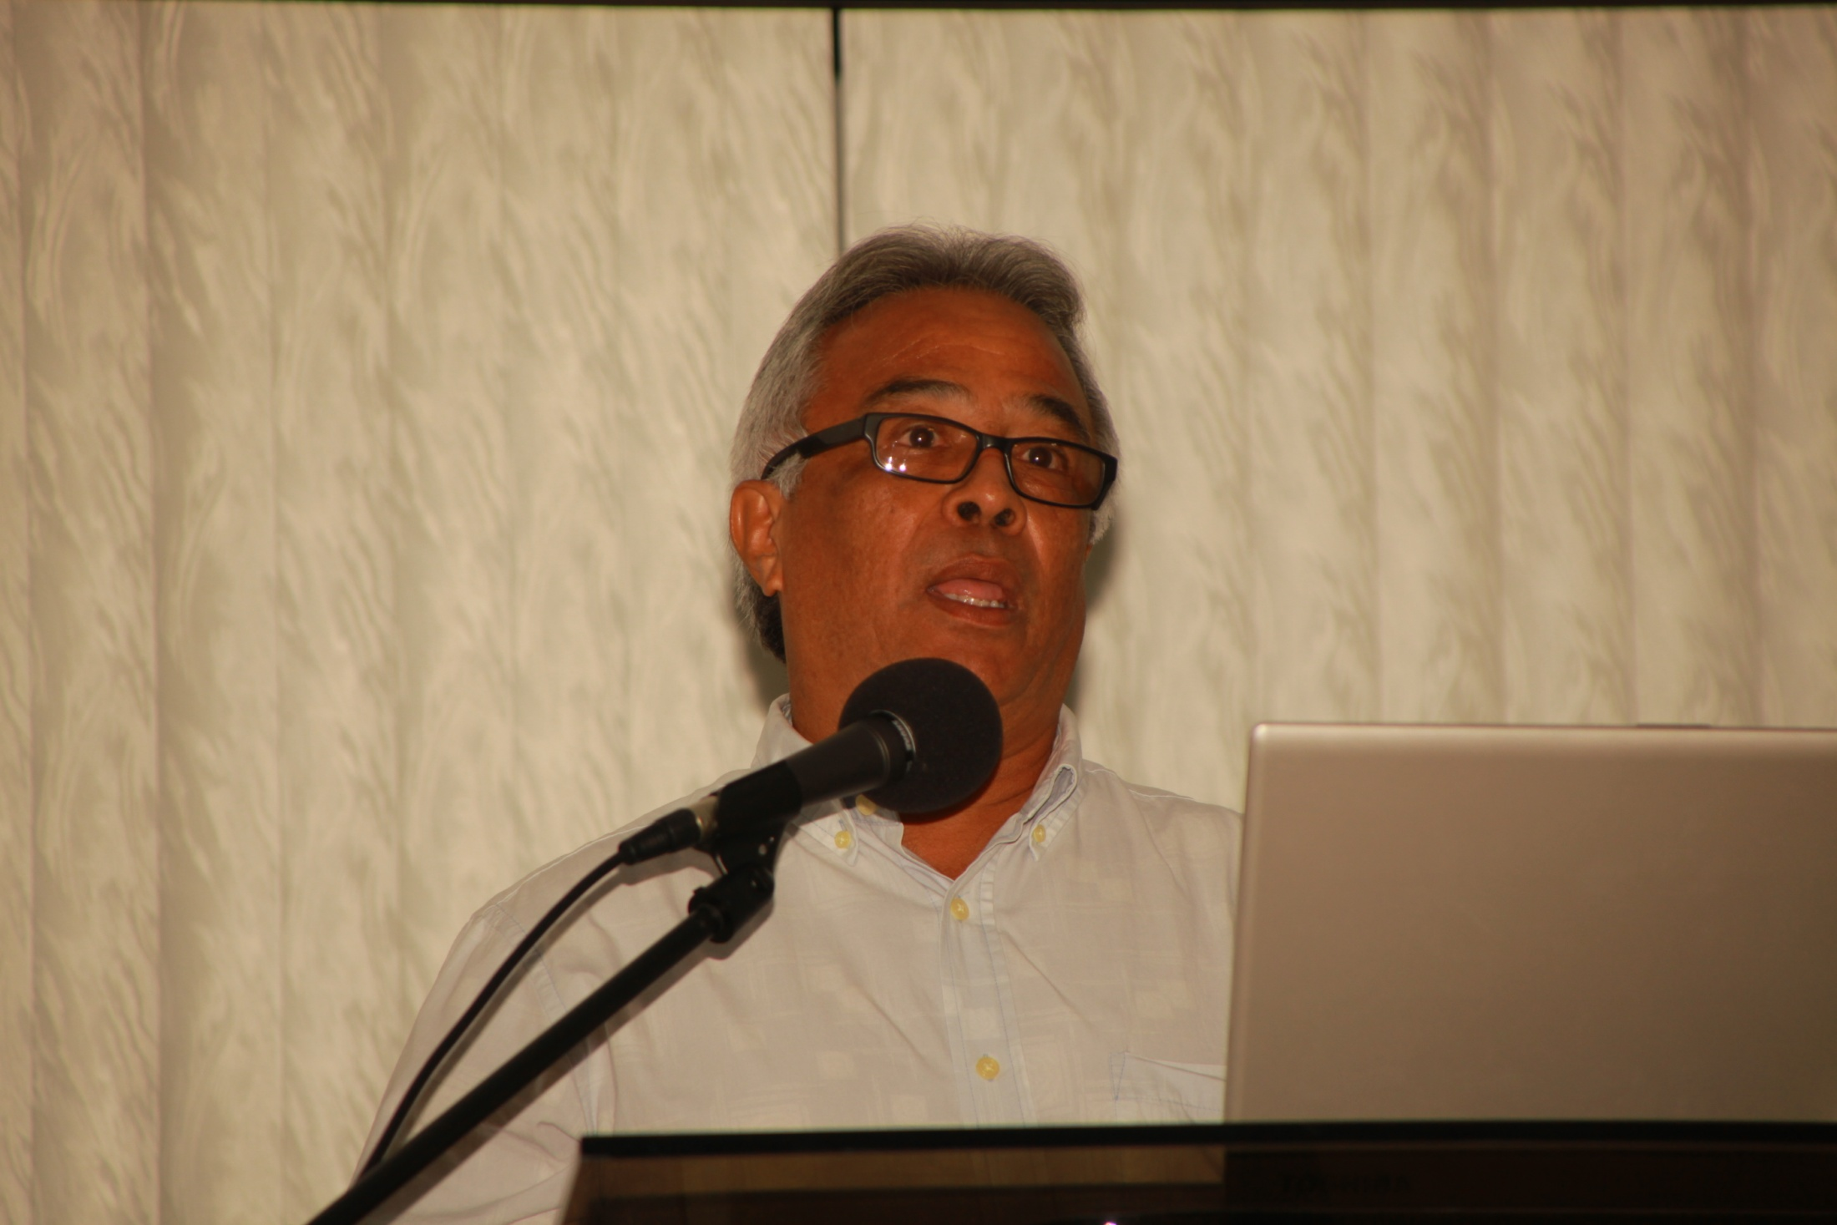
Speaking on behalf of the Sabana Hoyos congregation, Eulogio Pantoja is, as he repeatedly affirms, a product of the School of Advanced Bible Studies. And a good one, too! He is now one of the directors and teachers of the School.
Enrolling years back in the School, he almost dropped out, as he later told us, thinking he could not make the grade, but encouraged to continue, he obtained a Six-Year Certificate, and has honed his talents so as to become outstanding.
Sabana Hoyos is one of the first places the Shappley’s worked in Puerto Rico. Dewayne and Cheo Colón, a Christian recently arrived from New York, went house-to-house in the area, encouraging and teaching, efforts contributing to the restoration of a congregation already existing there.
Carlos Pantoja, older brother of Eulogio, has been a strong leader in the Sabana Hoyos church for many years. Also a director and teacher of the School of Advanced Bible Studies. His deteriorating health kept him from attending the activity.

Slide 31
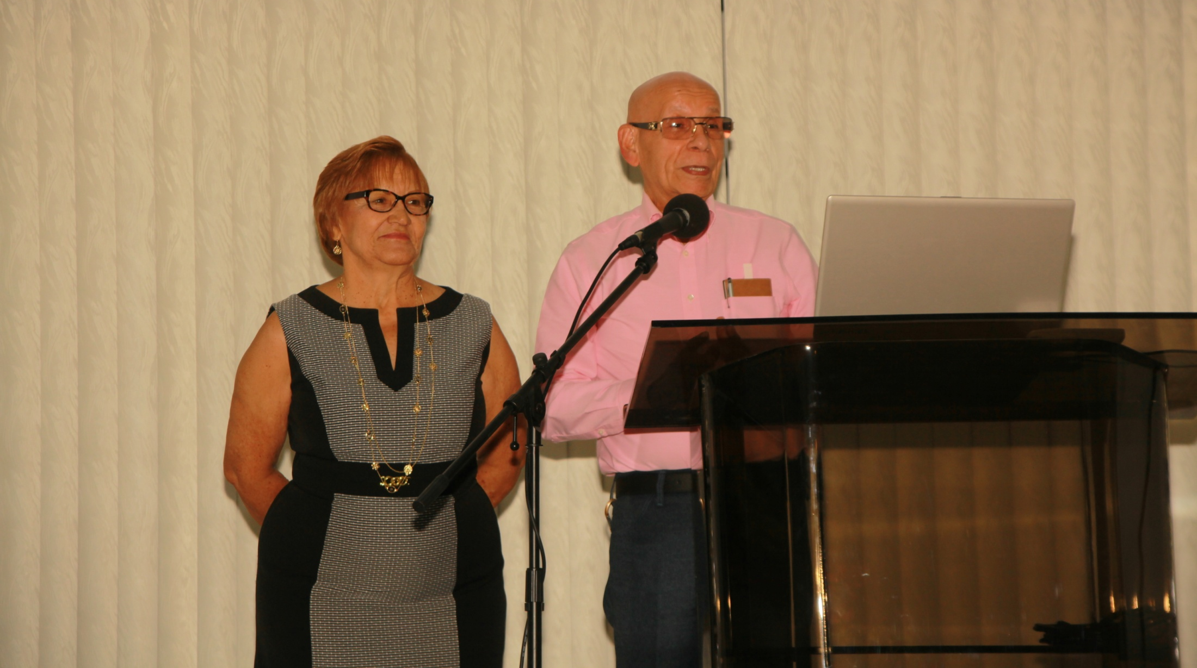
Juan and Lucín Camilo, of the Barrio Cubuy church, speak of their experiences with the Shappley’s. Juan, a barber, elder of the Cubuy church for many, many years, and his very capable wife, Lucín, have done so much for the church in Puerto Rico that it would take a sizable book to recount them all. And, at their own expense! Rita and Lucín have spent endless hours together, working on all kinds of projects: fellowship activities, property maintenance, printing plant jobs. Strong ties bind the two families.

Slide 32
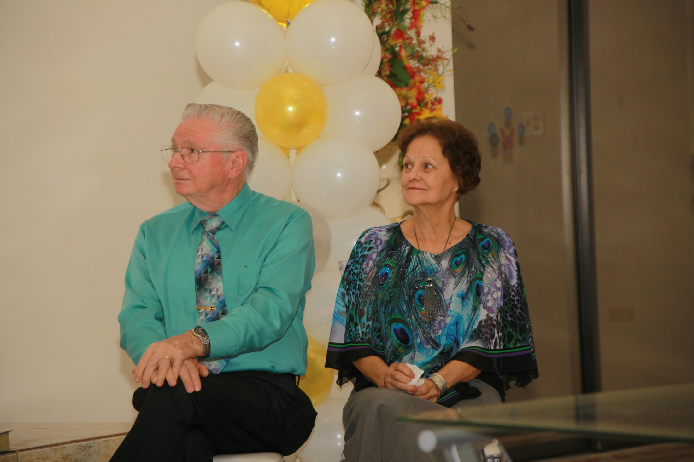
And through it all, Rita and Dewayne just sit there, taking it in, thankful beyond mea-sure to have been associated with such wonderful Christians. Some of the speakers even told funny things we did, or humorous situations in which we found ourselves!

Slide 33
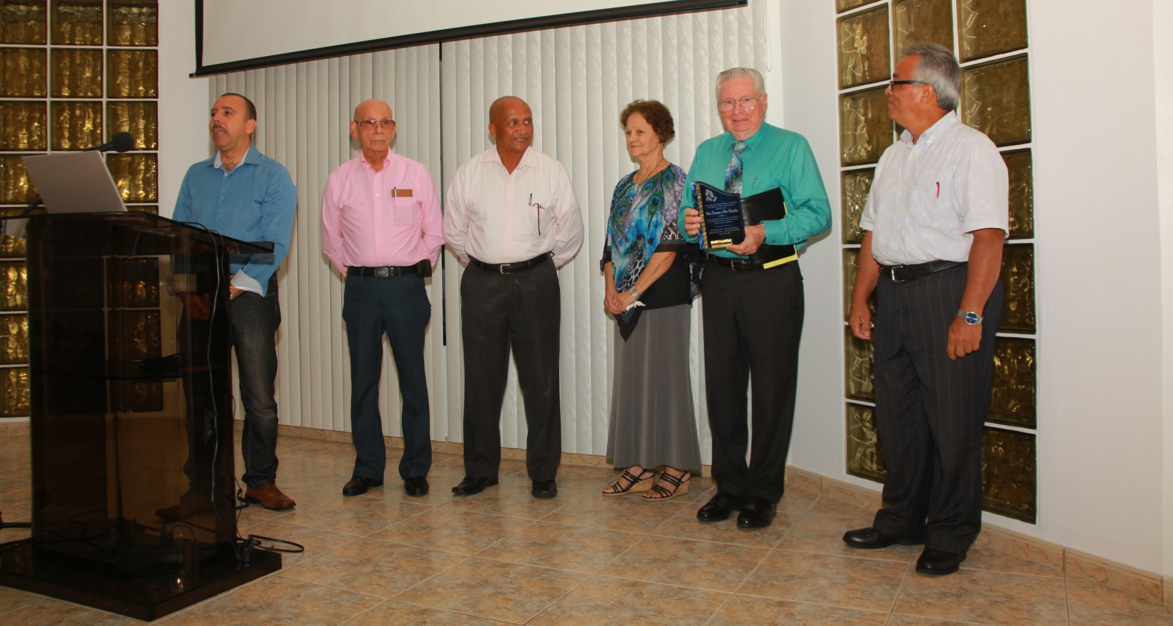
We were genuinely and pleasantly surprised when directors and teachers of the School of Advanced Bible Studies took the platform to speak of our work with the School and present us a plaque in appreciation.
From the left, Jorge Ginés, Juan Camilo, José Vizcarrondo, Rita, Dewayne and Eulogio Pantoja. Because of illness, Carlos Pantoja could not be present. 36 Monday nights each year; nine classes -3 on each of 3 levels. Break for food, Rita and Lusín being the official organizers of this part. Dewayne was challenged to produce a large amount of materials for classes, courses of this nature, in Spanish, not being readily available.

Slide 34
On behalf of the Shappley family, Dewayne thanks all who spoke for their words of appreciation and encouragement, also expressing gratitude to all who came for making this such an unforgettable event, so full of brotherly love and joy in the Lord. He observes that he would like to have the opportunity to testify to the abundant works of congregations and individual Christians in Puerto Rico carried out across the years.
Indeed, these self-supporting congregations, each with its own building, have done, and are doing, substantial evangelistic and benevolent works. Not only in Puerto Rico, but also in the Dominican Republic, El Salvador and India.

Slide 35
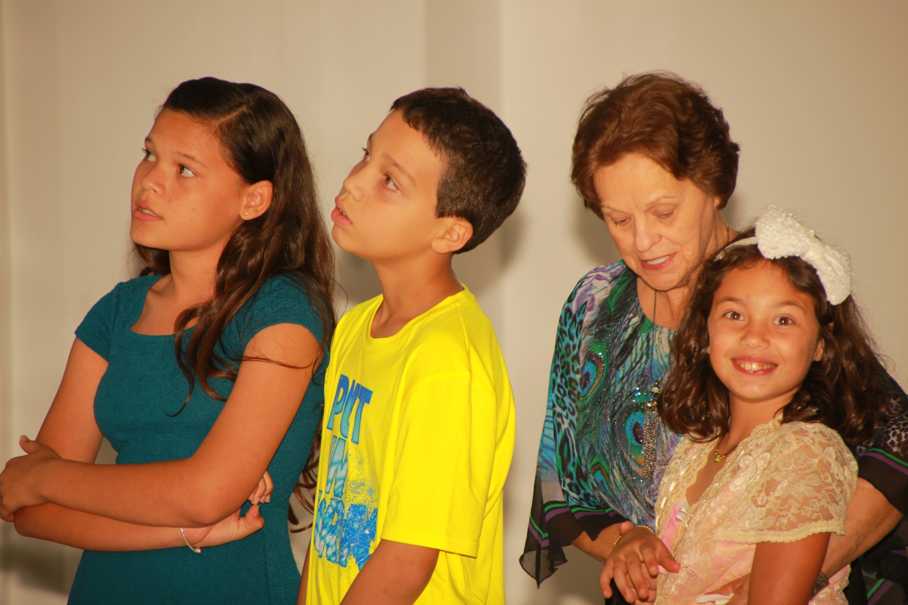
Karina Ramos and Yadiel Pérez, children of Omayra and Mirnita Sardina. All of them taught by Rita! Our granddaughter, Kiara Karina, sitting in Rita’s lap. At least two of them are listening to Dewayne!

Slide 36
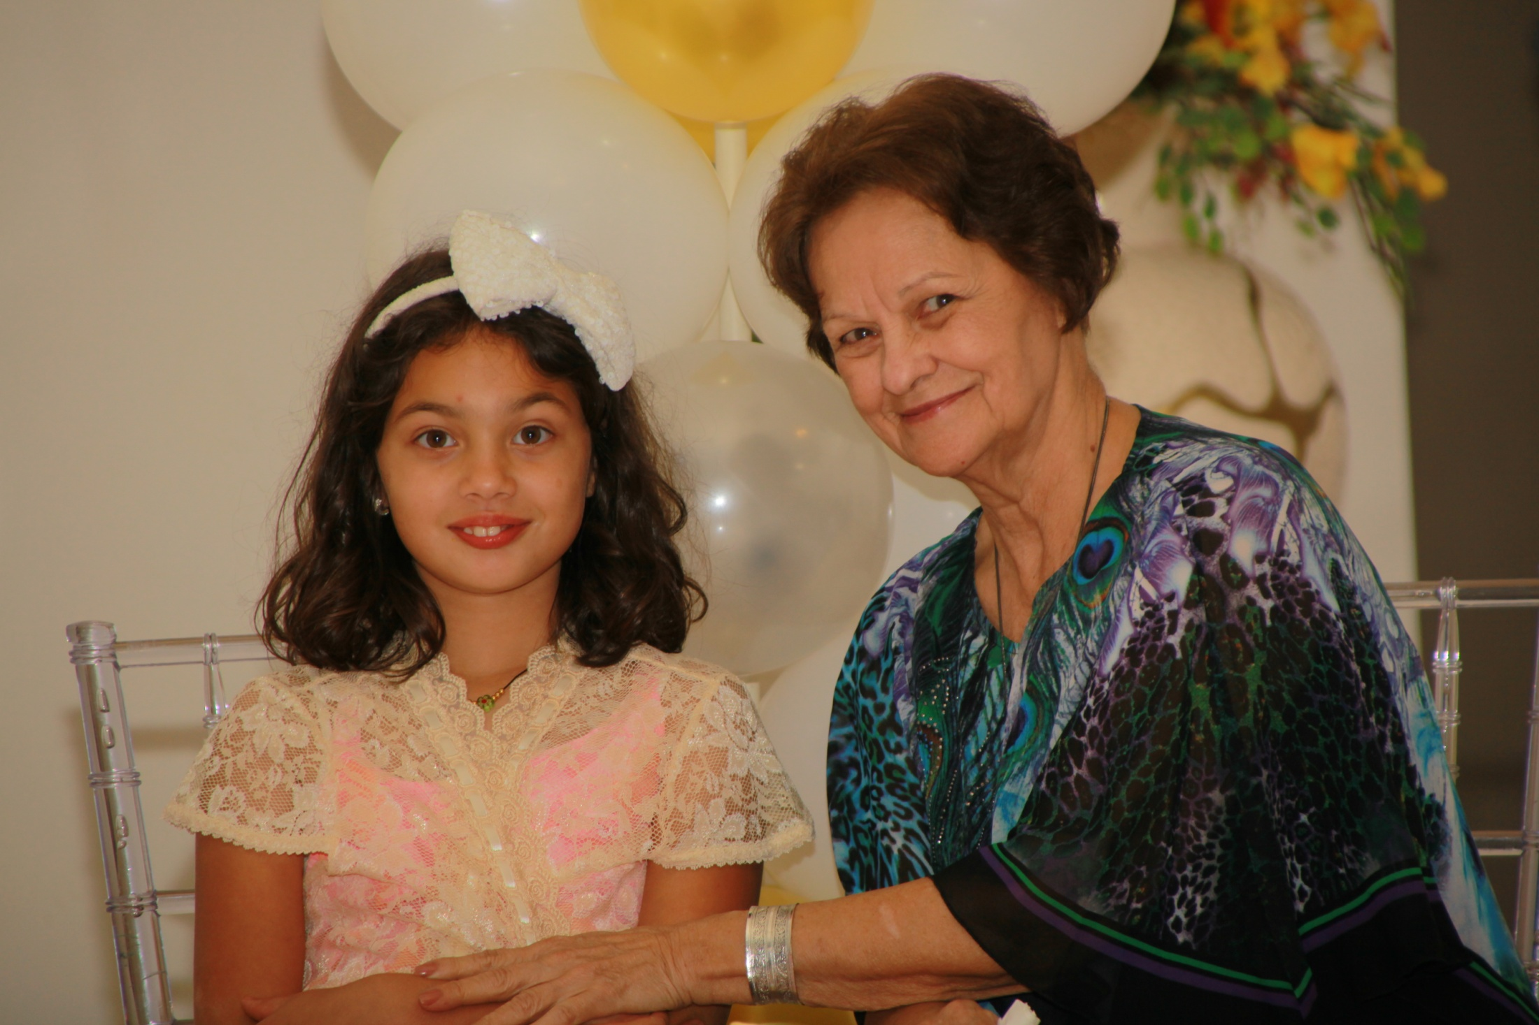
Kiara Karina sitting with her nana Rita. Not a few children and young people in Puerto Rico, especially in the Bayamon church, look upon Rita as their “nana” too, and some of them as “like a mother to me” in many ways.

Slide 37
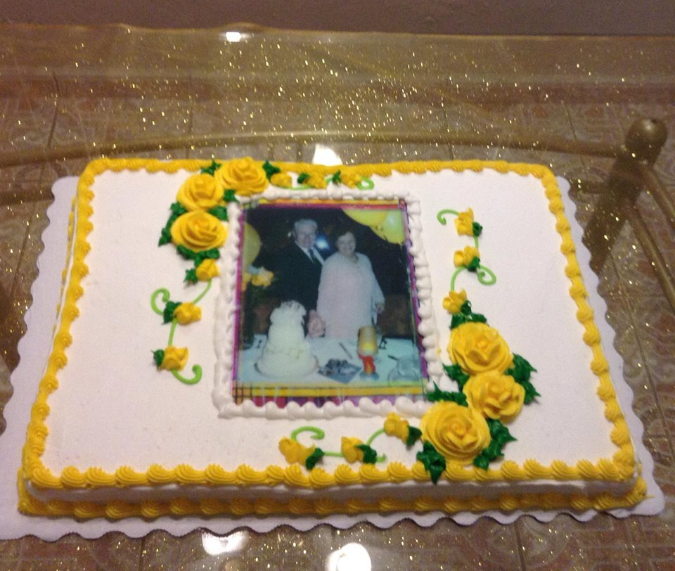
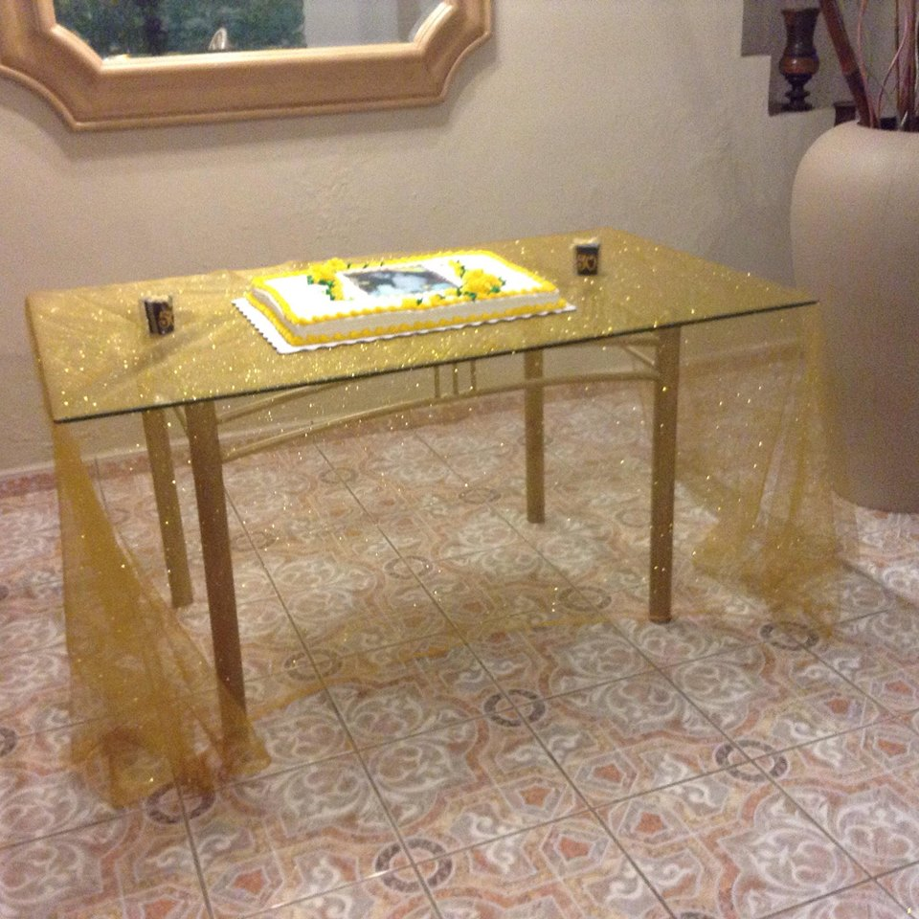
The full dinner after the ceremony included this cake on a gold-flecked tablecloth.
The picture on the cake was from the Shappley’s Golden Wedding Anniversary, celebrated eight years ago.
The event held April 30, 2016 was to celebrate their fifty years of work in Puerto Rico, and bid them “Farewell”, as they would be leaving May 5 for a new beginning in Florida.

Slide 38
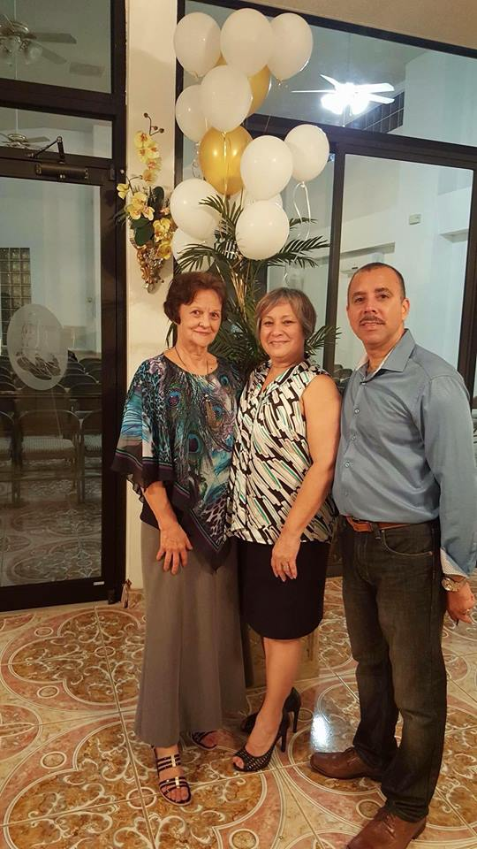
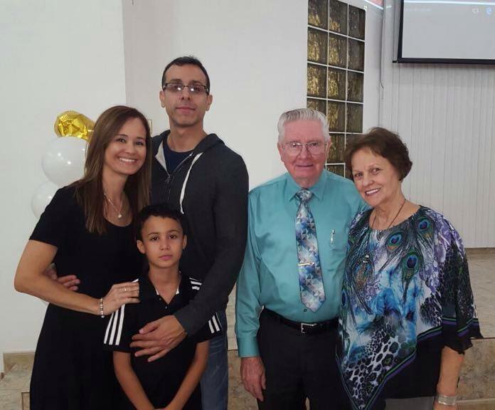
Left. Major credit for planning and decoration goes to Wanda Reyes and her husband, Jorge Ginés, of the Bayamon church, standing here with Rita.
Above. The Shappley’s with Ramón Ramos, Dali and their son, Mauricio. Many pictures like this one, with individuals, were taken. Precious moments to be treasured forever.

Slide 39
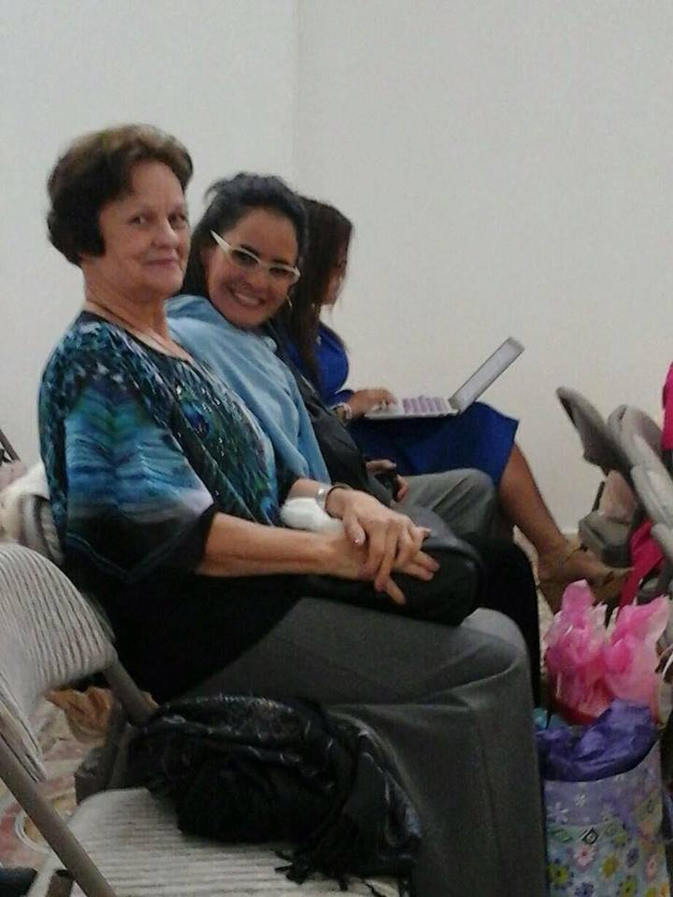
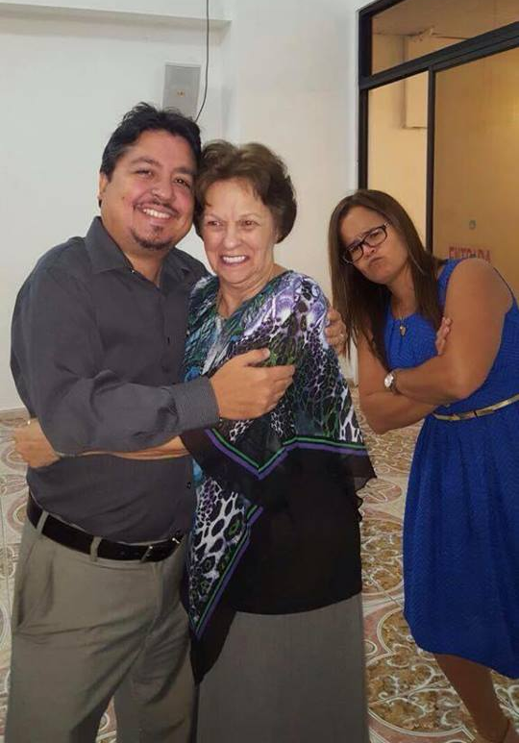
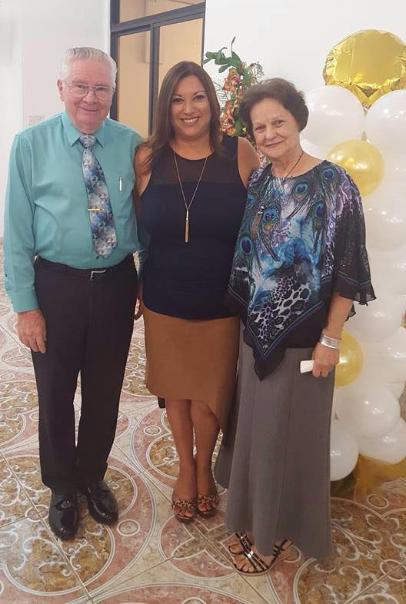
And, these…
Rita and Gabriel give a hug. Could Yanitza, right, be jealous? No way! Or, maybe? Dewayne performed the wedding ceremony for Gabriel and Yanitza three years ago.
The Shappley’s with Vilma Venegas, whom we have known since childhood. She and her husband, Dr. Javier Santiago, are members of the Park Gardens church. He is in Kuwait.
Above
Rita, Lili and her sister, Yanitza. These two young women, plus their sister, Dali, and mother, Nilsa, have been like close family to the Shappley’s for more than forty years.

Slide 40
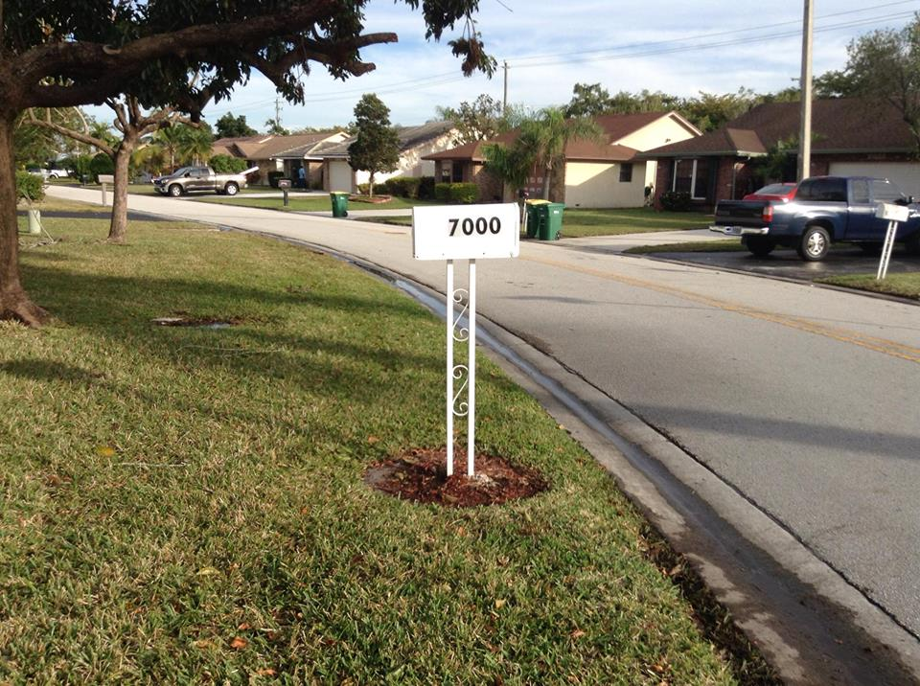
Here, Dewayne continues his work of evangelism and edification through the Internet, with more than 5,000 visits daily.
He and Antonio plan to soon be adding 6 to 15 minute video messages, including Scribe video.
More Spanish-speaking live in South Florida than in Puerto Rico, but there are fewer churches. Cuba is nearby, with 11,000,000. Opportunities to preach and teach abound.
With continued funding, present works may be expanded and new initiatives taken, building on the knowledge and experience acquired through 50 years in Spanish-speaking fields.
NEW ADDRESS for the Shappley’s
7000 NW 103 Ave., Tamarac, FL 33321
Isles of Tamarac is a community for 55 and above. Quiet and pleasant. 12 to 15 minutes from where Antonio and family live in Coral Springs.
787-930-0307 787-732-4444
hshappley@yahoo.com

